Slide 1
Meaning and Importance of Life Insurance
Life Insurance can be defined as the contract between an insurance company and a policy holder in which insurance company agrees to pay sum of money in exchange for the premium, upon the death of the policy holder or after the maturity period.
For Example: Whole Life insurance, term life insurance, endowment life insurance etc.
Some major life insurance companies of Nepal are:
Nepal Life Insurance
National Life Insurance
Asian Life Insurance
Life Insurance Company Ltd.
Rastriya Beema Sansthan etc.
There are 14 life insurance companies in Nepal so far.

Slide 2
Features of Life Insurance
Insurer or Insurance Company: An entity that provides the life insurance to the policy holder is known as insurer.
Insured: An insured is a person or policy holder who buys the insurance policy.
Insurance Policy: Insurance policy is the contract between the insurance company and policy holder that contains the terms and conditions of the insurance.
Insurance premium: The money you pay regularly to keep the life insurance policy active
Insured amount: The fixed amount of money paid to the family or nominee when the insured person dies.
Insurance period: The length of time for which the life insurance policy provides coverage.
Insurance policy loan: A loan you can take from the insurance company using your policy as security. Maximum of 90% of surrender value (premium paid + accrued bonus) is provided as loan.

Slide 3
Importance of Life Insurance
Providing security: Life insurance protects the family financially if the earning member dies, for example, the insurance money helps pay for daily expenses and education.
Shifting of risk: The risk of financial loss due to death is transferred to the insurance company, for example, instead of the family suffering loss, the insurer pays the amount.
Providing investment opportunity: Some life insurance policies help grow money over time, for example, endowment plans give returns after a fixed period.
Encourage saving: Regular premium payments develop a habit of saving, for example, a person saves money every month through premiums.

Slide 4
Capital formation: Insurance companies collect premiums and invest them in big projects, for example, building roads or power plants.
Generating employment opportunity: Life insurance creates jobs, for example, agents, officers, and customer service staff work in insurance companies.
Promoting social welfare: Insurance supports families in difficult times, for example, dependents get financial help after the policyholder’s death.
Improving credit standing: A life insurance policy helps in getting loans easily, for example, banks trust insured persons more.
Tax benefit: Life insurance gives tax savings, for example, insurance premium upto Rs. 40,000 can be reduced from taxable income.

Slide 5
Premature Death
Premature death can be defined as the death of a family head with outstanding unfulfilled financial obligations, such as support for the dependents education of children, payment of loan etc.
Premature death can cause serious financial problem for the surviving family members because their share of breadwinners earning is lost forever.
Cost of Premature Death:
Family’s breadwinners earning is lost forever.
Additional expenses are incurred due to funeral expenses, medical bills, taxes, loan repayment etc.
Reduction in the standard of living.

Slide 6
Financial Impact of Premature Death
Premature death has more severe financial impact on the certain types of families, they are classified as following:
Single people: Premature death of a single person who has no dependent to support is not likely to create a financial problem for others.
Single parent families: single parent families are increasing due to death of spouse, divorce, legal separation etc and in case of single parent families, if a family heads dies prematurely, the surviving children have to experience great financial insecurity.
Two Income Earners: in case of both spouse are income earner, the surviving spouse may have to suffer considerable financial insecurity if one spouse dies in family because the income of both is need to maintain the family’s standard of living. Hence, large amount of insurance is needed.

Slide 7
4. Traditional Families: in traditional families, one spouse is working and other parents stays at home to take care of dependent children. If working person dies prematurely, surviving spouse and children has to face t he greater financial insecurity.
5. Blended Families: A blended family is one in which a divorced or a widowed spouse with children remarries and the new spouse may be widower also has children. In such case, If working spouse dies prematurely, surviving members has to face t he greater financial insecurity.
6. Sandwiched Families: A sandwiched family is one in which a son or daughter which children is also supporting one or both parents. Thus, the son or daughter is “sandwiched” between the younger and older generation. Hence, the premature death of working spouse can result financial loss to surviving members. These types of families should be protected by life insurance.

Slide 8
Amount of life insurance of own
Amount of life insurance of won represents the monetary value of your insurance policy. Three approaches can be used to estimate the amount of life insurance to won.
Human Life Value Approach: If the family head dies prematurely, the breadwinner’s earning is lost in the family, this loss is called the human life value . Hence, human life value can be defined as the present value of the deceased breadwinners future earning. It can be calculated as:
Step 1: Estimate the individuals average annual earnings over his/her productive life time.
Step 2: Deduct federal and state income tax, SST, health insurance premium and the cost of self maintenance.
Step 3: Determine the number of years from the persons present age to the contemplated age of retirement.
Step 4: Using the reasonable discount rate, determine the present value

Slide 9
For Example: Ram, age 45, is married with two children in high school. He estimates that his average annual earnings over the next 20 years will be Rs 600,000. He estimates that one third of his average annual earnings will be used to pay taxes, insurance premiums, and the costs of self maintenance. The remainder will be used to support his family. Richard wants to calculate his human life value and believes a 6 percent discount rate is appropriate. Calculate Ram's human life value.
Solution:
Current Age = 45
Remaining working years = 20
Average annual earning = Rs. 600,000
Personal expenses (taxes, premium, self maintenanace cost) = 1/3rd of earning (i.e. 1/3*600000 = Rs. 200,000)
Contribution to family = 2/3rd of earning (i.e. 2/3*600000 = Rs. 400,000)
Discount rate = 6%

Slide 10
Ram’s contribution to family = Rs. 400,000
Now, apply the present value of annuity formula to calculate the Ram’s human life value;
Hence, Human Life value is the present value of Rs. 400,000 ram contributed to the family every year for 20 years discounted at 6%
Human Life Value = Annual contribution to family * PVIFA, k,n
= 400000* PVIFA, 6%,20
= 400000*11.4699
= Rs. 4,587,960

Slide 11
2. Needs Approach : As per this approach, the various family needs that must be met if the family heads dies are analyzed and the amount of money needed to met those needs are determined. The amount of existing life insurance and financial assets is then subtracted from the total amount needed.
The family needs are classified as cash needs, income needs, and special needs.
Cash Needs: Cash is immediately needed after the death for funeral expenses, uninsured medical bills, installment payment, tax payment etc.
Income Needs: The income needs include the income during readjustment period, income during dependency period and income to surviving spouse. The readjustment period is the period of 1 to 2 years after the death of family head. Dependency period is the period until the youngest child reaches 18. For all these cases, the family is in need of income.

Slide 12
Special Need: Families should also consider certain special needs including loan repayment for rent, educational fund of children, or some emergency cases. Under such special cases, family needs income.
Total Needs = Cash Needs + Income Needs+ Special needs
Additional Life insurance needed = Total Needs – total assets

Slide 13
Example: Kelly, age 40, is a single parent and has a one-year old son. She earns $45,000 annually as a marketing analyst. Her employer provides group life insurance in the amount of twice the employee’s salary. Kelly also participates in her employer’s 401(k) plan.
She has the following financial needs and objectives:
Funeral costs and uninsured medical bills $ 10,000
Income support for her son $2,000 monthly for 17 years
Pay off mortgage on home $150,000
Pay off car loan and credit card debts $15,000
College education fund for son $150,000
Kelly has the following financial assets:
Checking account $ 2,000
IRA account $8,000
401(k) plan $25,000
Individual life insurance $25,000
Group life insurance $90,000

Slide 14
Ignoring the availability of Social Security survivor benefits, how much additional life insurance, if any, should Kelly purchase to meet her financial goals based on the needs approach? (Assume that the rate of return earned on the policy proceeds is equal to the rate of inflation.)
Solution:
Particular | Amount
Funeral cost and uninsured medical bills | $10,000
Pay off mortgage on home | $150,000
Pay off car loan and credit card debts | $15,000
College education fund for son | $150,000
(A) Total Cash Needed | $325,000
(B) Income needed for the education of her son ($2000*17 years*12) | $408,000
(C) Total Needs (A+B) | $733,000
Less: Existing assets
Checking account | $2,000
IRA Account | $8,000
401 (k) plan | $25,000
Individual life insurance | $25,000
Group life insurance | $90,000
(D)Total Assets | $150,000
New Life Insurance Needed | $583,000

Slide 15
b. How much additional life insurance, if any, is needed if estimated Social Security survivor benefits in the amount of $800 monthly are payable until her son attains age 18?
Solution:
Particular | Amount | Amount
(A) Total Cash Needed |  | $325,000
Income needed for the education of her son ($2000*17 years*12) | $408,000
Less: Social security benefit of $800 per month for (18-1) years | $163,200
(B) Actual income needed | $244,800 | $244,800
Total Needs (A+B) |  | $569,800
Less: Total Assets |  | $150,000
New Life Insurance Needed |  | $419,800

Slide 16
3. Capital Retention Approach: This approach is also known as capital needs analysis. This approach preserves the capital needed to provide income to the family. Under this approach, the amount of life insurance needed can be determined by the following step:
Step 1: Prepare a personal balance sheet: list all the personal assets and liabilities including all death benefit from insurance and other source.
Step 2: Determine the amount of income producing capital: This step is performed by subtracting the liabilities, cash needs, and non income producing capital from total assets.
Step 3: Determine the amount of additional capital needed: In this step, income objective is compared with other income sources such as social security survivor benefit.

Slide 17
For Example: Janet, age 30, is married and has a son, age 4. She wants to determine how much life insurance she should own based on the capital retention approach. She would like to provide $30,000 each year before taxes to her family if she should die. She owns a house jointly with her husband that has a current market value of $250,000 and a mortgage balance of $100,000. She also owes $16,000 on a car loan and credit cards. She would like to have the mortgage, car loan, and credit card debts paid off if she should die. She has no investments, and her checking account balance is only $1000. She owns an individual life insurance policy in the amount of $100,000 that her parents purchased for her when she was a baby. Estimated Social Security survivor benefits are $10,000 annually. Janet assumes the life insurance proceeds can be invested at 5 percent interest. Based on the capital retention approach, how much additional life insurance, if any, should Janet purchase to meet her financial goals?

Slide 18
Solution:
Step 1: Prepare personal balance sheet:
Step 2: Determine the amount of income producing capital
Janat will need an additional $15000 of life insurance just to pay her debt
Assets | Amount | Liabilites | Amount
House | $250,000 | Mortgage (Loan) Balance | $100,000
Checking account balance | $1,000 | Car and credit card loan | $16,000
Individual life insurance policy | $100,000
Total | $351,000 |  | $116,000
Total Assets |  | $351,000
Less: Non income producing capital
Mortgage pay off | $100,000
Car and Credit card loan | $16,000
Value of home | $250,000 | $366,000
Total income producing capital |  | ($15,000)

Slide 19
Step 3: Determine the amount of additional capital needed
Particular | Amount
Income objective for family | $30,000
Capital now available for income | 0
Social security survivor benefit | $10,000
Income shortage | $20,000
Total new capital required (20000/0.05) | $400,000

Slide 20
Types of life insurance
Term insurance: Term life insurance provides financial protection only for a specific period (the term) - or example, 1, 5,10, 20, or 30 years. If the person insured dies during that term, the insurance company pays a death benefit (a lump sum) to the beneficiaries. If the term ends and the policyholder is still alive, typically no benefit is paid and coverage ends unless you renew or convert it.
Term insurance is appropriate when income is limited, when the need is temporary to get insured because it has no cash values as it cannot be used for retirement or saving purpose.
Characteristics of term insurance:
Protection period is temporary: Like 1, 5, 10 years or defined time period, unless it is not renewed, protection expires after that time.
Renewable: Term insurance are renewable in nature
Convertible: It can also be converted into cash value policy

Slide 21
Types of term insurance:
Yearly renewable term: It is issued for a one-year period, and the policyholder can renew for successive one-year periods to some stated age. Premiums increase with age at each renewal date.
5,10,15 or 20 years term: Term insurance can also be issued for 5, 10, 15, 20, 25, or 30 years. The premiums paid during the term period are level, but they increase when the policy is renewed.
Term to age 65: A term to age 65 policy provides protection to age 65, at which time the policy expires. The policy can be converted to a permanent plan of insurance, but the decision to convert must be exercised before age 65.
Decreasing term: It is a form of term insurance where the face amount gradually declines each year. However, the premium is level throughout the period. For Example: If you have a 25‑year home loan, a decreasing plan might start with a $150,000 benefit that goes down each year as your mortgage balance drops. If you pass away in year 10, your family gets the then‑remaining amount.
Reentry term: Re‑entry term life insurance is a special kind of term life policy with a chance to get lower premiums again when you renew it.

Slide 22
2. Endowment Insurance: Endowment insurance is a type of life insurance that pays a guaranteed lump-sum amount either when the policy matures (after a set period) if policy holder is alive, or to your beneficiaries if policy holder dies during the policy term. Endowment life insurance is a saving plan.
For Example: If Sikshya, age 27, purchases a 20-year endowment policy and dies anytime within the 20-year period, the face amount is paid to her beneficiary. If she survives to the end of the period, the face amount is paid to her.
Endowment insurance can be viewed from two perspective:
i. Mathematical Concept: under this concept, insurer makes two promises, the first one is a) to pay the face amount if the insured dies during the period – term insurance and b) to pay the face amount if the insurer survives to the end of the endowment period – pure endowment.

Slide 23
ii. Economic Concept: As per this concept, the endowment plan is divided into two parts: increasing saving and decreasing term insurance. When the term insurance is decreased, people choose endowment as saving plan.
Types of endowment policies:
Single premium endowment policies: You pay one big payment (premium) when you buy the policy instead of paying small amounts over many years. The insurer then gives you money later either at the end of the policy term or if you die earlier. For example: Mr. Rai has Rs. 2,00,000 in savings. He buys a single premium endowment policy by paying Rs. 2,00,000 once. After 15 years, the policy matures, and he gets a lump sum of Rs. 3,00,000 as a maturity benefit.
Semi endowment policy: A semi-endowment policy pays only half the value of the normal endowment payout either when the policy matures or when the insured dies. For example: Ms. Koirala has a semi-endowment policy with Rs. 1,00,000 sum assured. If she survives the term, she gets Rs. 50,000 (half the amount). If she dies during the term, her family gets Rs. 50,000 as death benefit.

Slide 24
c) Modified endowment policies: Modified endowment policies provide the payment periodically of a set percentage of the insured amount over the policy term as well as a maturity amount. For Example: Ramesh buys a modified endowment policy with a Rs. 1,00,000 sum assured and over its 15-year term he receives periodic payouts (for example 10 % after 3 years, 15 % after 6 years and 20 % after 9 years) and then the remaining amount with any bonuses at the end of the policy.
d) Deposit term: A deposit term endowment is a type of endowment where the first year’s premiums are higher than later ones, and the benefit at maturity is based on deposits made (what you paid over time). For Example: Mrs. Lama buys a deposit-type endowment policy where she pays Rs. 20,000 in the first year and Rs. 10,000 each year after for 10 years. At the end of the 10 years, she gets back a lump sum that reflects all her deposits plus any additions the insurer provides.

Slide 25
e) Juvenile endowment policies: A juvenile endowment policy is bought for a child (usually by parents). It is meant to provide money when the child grows up - e.g., for education, marriage, or starting a life. For Example: Mr. and Mrs. Gurung buy a juvenile endowment policy for their baby daughter. After 18 years, when she finishes school or enters college, the policy matures and pays her Rs. 5,00,000 to help pay for higher education or other goals. If something happens to the child before maturity, the beneficiary still gets a death benefit.

Slide 26
3. Whole Life Insurance: Whole life insurance is a permanent life insurance policy that provides coverage for your entire lifetime as long as you continue to pay the required premiums. It also builds a cash value (savings-like component) that grows over time.
Types of Whole Life Insurance:
1. Ordinary Life insurance: The ordinary life insurance is also called straight life insurance and it is whole life is often used for ordinary life insurance. Ordinary life insurance provides coverage for your entire life as long as you keep paying the premiums; the insurer pays the death benefit to your beneficiaries whenever you die, no matter how old you are. The premiums are payable as long as the insured lives.
For Example: Mr. Rai buys an ordinary life insurance policy with a Rs. 20,00,000 sum assured and pays a fixed annual premium every year throughout his life; when he eventually passes away at age 78, his family receives the Rs. 20,00,000 death benefit.

Slide 27
2. Limited Payment Life Insurance: Limited payment life insurance is a type of whole life insurance where you pay premiums only for a set number of years say 20 or until age 65, but your coverage stays in force for your entire life even after the payments stop.
For Example: Mr. Sharma buys a 15‑year limited payment life insurance policy with a Rs. 50,00,000 sum assured; he pays higher annual premiums for 15 years, and after that his insurance continues for life without any more payments, and his family will get Rs. 50,00,000 if he dies at any age.

Slide 28
Variations of Whole Life Insurance
The new products under the whole life insurance have developed over the period of time considering the cash value and rate of return. Some of the new form of Whole life insurance policies are:
1. Variable life Insurance: Variable life insurance is a permanent life insurance policy that not only provides a death benefit to your beneficiaries when you die, but also lets you invest part of your cash value in market‑linked options (like stocks and bonds), so the value can go up or down depending on investment performance, and both the cash value and sometimes the death benefit can vary based on how your chosen investments do.
Here, You pay premiums into the policy, and part of that money goes into a separate investment account that is offered by the insurance company and you can choose among the available investment options for making investment.

Slide 29
2. Universal Life Insurance: Universal life insurance is a type of permanent life insurance that gives you lifelong coverage as long as you pay premiums, but unlike traditional whole life insurance, it lets you change how much you pay and how much your policy’s savings (cash value) grows over time.
In universal life insurance, You can pay more, less, or sometimes skip payments (within set limits), as long as the policy’s savings can cover costs. Similarly, you can change your premium amount or the death benefit (the money paid when you die) to fit your changing needs.
For Example: Mr. Thapa buys a universal life insurance policy with Rs. 50,00,000 coverage; some of what he pays each year goes into a savings part that earns interest, and because he can choose to pay more in good years or less in tight years, he keeps the policy active as long as the cash value and premiums are enough - and his family will still get the death benefit when he dies.

Slide 30
3. Variable Universal Life insurance: Variable Universal Life Insurance (VUL) is a type of permanent life insurance that not only gives you a death benefit for your whole life (as long as you pay premiums), but also lets you invest part of your cash value in market‑linked options (like stocks and bonds), so the value can go up or down based on how those investments perform.
For Example: Rina buys a VUL policy with Rs.1,00,00,000 coverage; each year part of her premium goes into a savings account that she chooses to invest in a mix of stock and bond funds — if those investments do well, the cash value grows and may increase her death benefit, but if they do poorly, the cash value can drop and she might need to pay more to keep the policy active.
In short: VUL = lifetime protection + investment choice + flexible payments, with higher growth potential but also investment risk.

Slide 31
Other Types of Life Insurance
Modified Life Insurance: It is a whole life policy in which the premiums are lower for the first 3 to 5 years and higher thereafter, but comparatively less than that of traditional whole life insurance. The major advantage of this insurance is that an applicants for insurance can purchase permanent insurance immediately even though they cannot afford higher premium for the regular whole life policy.
Preferred Risk: in this policy, the insurance company sells the policy at lower rate to the individuals whose death probability (Preferred Risk) is expected to be lower than average. This is customized policy which is sold to the individual considering their health history, weight, occupations, who seems to have low mortality rate than average. For example: discount in life insurance for the non smoker is an example.

Slide 32
3. Joint Life insurance: Also called first-to-die policy, is a policy written in the lives of two or more people and is payable at the time of the death of the first person to die. For example, this policy can be used for the coverage of husband and wife.
4. Second-to-die life insurance: Also called survivorship life is a form of insurance that insurers two or more lives and pays the death benefit at the time of the death of the second or last insured.
5. Saving bank life insurance: It is a life insurance that was sold by saving banks to their customers at lower premium.
6. Group life insurance: Group life insurance provides the life insurance to the members of a group in a single master contract between the insurer and employer. For example: Group medical insurance.

Slide 33
Life Insurance Contractual Provisions
A life insurance contractual provision is a specific clause or term written into a life insurance policy that defines the rights, duties, conditions, and responsibilities of both the insurer and the policyholder.
Ownership Clause: Under the ownership clause, the policy owner posses all contractual rights in the policy while the insured is living. These rights include changing the beneficiary, surrendering the policy, borrowing the loan, receiving dividend etc.
Entire Contract Clause: Entire contract clause states the only terms and conditions that count between you and the insurance company are the ones that are written in the actual policy and the application documents attached to it - nothing outside the written contract is enforceable.

Slide 34
Incontestability Clause: Incontestability clause states that after the policy has been in force for a certain time (usually 2 years), the insurance company can’t cancel the policy or refuse to pay the death benefit just because you accidentally gave wrong information on the application. They must pay the claim as long as the policy is in force.
Suicide Clause: Suicide clause states that If the person who bought the life insurance dies by suicide within a certain early period after the policy starts - usually 1-2 years - the insurance company will not pay the full death benefit to the beneficiaries. Instead, they may only return the premiums paid. But, If someone dies by suicide after the suicide-clause period (1-2 years) from when the life insurance policy started, then the insurer will pay the full death benefit to the beneficiaries just like any other death (natural or accidental), as long as the policy is active and premiums were paid.

Slide 35
Grace Period: This clause states that if you miss a premium payment, the insurer gives you a little extra time to pay it without losing your coverage - usually about 30-31 days. During this time, your policy still works.
Reinstatement Clause: This clause states that if your policy lapsed (ended) because you didn’t pay premiums on time, the reinstatement clause lets you revive it later - but only if you meet certain rules (like paying back premiums + interest and proving you’re still healthy).
Misstatement of Age or Sex: This clause states that if you accidentally give the wrong information about age or sex when applying, the insurer doesn’t cancel the policy. Instead, they adjust the benefit or premium to what it should have been if your real age/sex had been given
Beneficiary Designation: This clause tells who will get the life insurance money when the insured person dies. The person you name in the policy is the beneficiary.

Slide 36
Change of the Plan Provision: This rule lets you switch your life insurance policy to a different type of policy that might suit your needs better - for example, moving from ordinary life to limited payment policy (or vice versa).
Exclusions and Restrictions: These are situations where the policy will not pay. For example suicide in the early period, death from criminal act, war and relative violence, dangerous hobbies, private flight by non commercial pilot etc.
Payment of Premium: This clause tells you how and when you must pay your premium money to keep the policy active. Premium can be paid annually, semi annually, quarterly, or even monthly.
Policy Loan Provision: If your policy has cash value (savings part), you can borrow money from the insurer using your policy as the source of the loan. For example: Your whole life policy has Rs. 1,00,000 in cash value. You can take a loan of Rs. 50,000 from that amount. You’ll pay interest, and if you don’t repay the loan, the amount plus interest will be taken from your death benefit.

Slide 37
Assignment Clause: The Assignment Clause allows you transfer your life insurance policy rights to another person or institution - like a bank - usually as security for a loan.
Absolute Assignment: This is a complete and permanent transfer of all rights and ownership from the policyholder to another person or entity.
Collateral Assignment: This is a special kind of conditional assignment where the policy is used only as security for a loan. The lender has rights only up to the loan amount.
Automatic Premium Loan: This clause states that if you forget to pay a premium and your policy has cash value, the insurer will use that cash value to automatically pay the overdue premium so the policy doesn’t lapse (end).

Slide 38
Dividend option
A dividend option is the choice you make about how you want to use the dividends that an insurance company pays you from a participating life insurance policy. Only participating or “with-profits” policies offer dividends such as participating endowment plan, participating whole life insurance etc.
The dividend can be used for the following options:
Cash: You receive the dividend in cash - usually by check or direct deposit.
Apply to payment of premium: The dividend can be used for the payment of your next due premium.
Dividend accumulation: Your dividend stays with the insurance company and earns interest over time (like a savings account).
Paid up additions option: Your dividend can be used to purchase small amount of life other insurance policies .
Term Insurance: Your dividend buys one year of additional term coverage (temporary life insurance).

Slide 39
Nonforfeiture Option
A nonforfeiture option is used in cash value life insurance which states that if you don’t want to continue your life insurance policy, the policyholder is entitled to receive something back as cash surrender value.
Means, you cannot loose every money that you have paid as a premium to the date of surrender of your policy.
For Example: You have purchased whole life policy 5 years ago. So far you have paid 50,000 amount as premium in 5 eyars and this amount has earned nearly Rs. 20,000 from the investment made by your insurance company. Now you have decided to cancel the policy, in such as case, your insurance company pays you back Rs. 70,000 and policy ends.

Slide 40
Common nonforfeiture options:
Cash surrender value: In this option, you can cancel the policy and get the cash value in lump sum. For example: You’ve paid premiums for 5 years and your policy has Rs. 50,000 cash value. If you choose this option, the insurer pays you Rs. 50,000 (minus any charges) and the policy ends.
Reduced paid up insurance: Under this option, the amount received from cash surrender is used to pay the single premium to buys a smaller permanent life insurance policy in which the premium is fully covered from that single payment.
Extended term insurance: In this option, Your cash value is used to buy a term life insurance policy with the same original death benefit but only for a limited period. For example: You had Rs. 10,00,000 of coverage and Rs. 4,00,000 cash value. The insurer uses Rs. 4,00,000 to buy term insurance of Rs. 10,00,000 that stays in force, maybe for 10 or 15 years, without needing future premiums.

Slide 41
Settlement option
A settlement option in life insurance is the method you (or your beneficiary) choose for receiving the insurance proceeds (like maturity or death benefit) instead of just getting one lump‑sum payment. The most common settlement options are:
Cash: Under this option, the policy proceeds can be paid in lump sum at once. No future payments is received after that.
Interest option: Under this option, The insurance company keeps the money and pays you just the interest periodically, preserving the principal. Principle can be paid in demand.
Fixed period option: under this option, the policy proceeds are paid to the beneficiary over some fixed period of time lets say for 5 years or 10 years. Payments can be made monthly, quarterly, semi annually or annually.

Slide 42
Fixed amount option: Under this option, you choose a fixed amount to be paid regularly until the death benefit plus interest runs out.
Life income option: Under this option, beneficiary get regular payments for life, like an annuity (monthly or yearly). It includes:
Life income: The beneficiary receives regular payments for as long as they live - basically an annuity. The insurer calculates the payment amount based on the death benefit, the beneficiary’s age, and life expectancy.
Life income with guaranteed period: You still get lifetime income, but with a minimum guaranteed period (e.g., 5 or 10 years). If the beneficiary dies before that period ends, the insurer keeps paying the same regular installments to a contingent beneficiary until the guaranteed period is over.
Life income with guaranteed total amount: The beneficiary receives lifetime income, and if they die before getting back the full value of the death benefit in total payments, the insurer continues payments until the total paid equals the original policy amount.
Joint and survivor income: This option provides lifetime income for two people - for example, a husband and wife. Payments continue as long as either is alive. Often, the payment amount to the survivor after the first person dies might be reduced (e.g., 100 %, 75 %, or 50 % of the original amount).

Slide 43
Additional life insurance benefits
Waiver of the premium provision: This is an additional benefit you can add to a life insurance policy so that if you become seriously ill or permanently disabled and cannot pay your premiums, the insurer waives all future payments while keeping your life insurance active. The policy doesn’t lapse just because you can’t pay. For example: Meera has a life insurance policy and adds this rider. If she gets into an accident and can’t work for years, she doesn’t have to keep paying premiums - yet her life insurance cover continues. Her family will still receive the benefit if she dies later.
Term Insurance Rider: A term rider isn’t one specific benefit - it refers to a group of optional benefits you attach to your life policy that add extra protection for a defined period. These riders cover situations like disability, income replacement after death, or extra payment for accidents. They expire after the chosen term. For Example: Rahul adds a term rider that provides a monthly income for his family if he dies in the next 20 years. If he passes away during that period, his family gets regular monthly payments on top of the base death benefit.

Slide 44
Guranteed Purchase option: This benefit lets you buy more life insurance in the future without a medical exam — even if your health gets worse — at specific ages or life events like marriage or childbirth. This locks in your insurability when you’re healthy. For Example: Sita buys a policy at 25 and adds this option. When she gets married at 30 and later has a child at 34, she chooses to buy extra insurance each time at standard health rates — without proving she’s healthy now.
Advance purchase privilege: This is a part of the Guaranteed Purchase Option that gives you extra chances to add insurance soon after major life events (like marriage or having children) without showing new medical evidence. For Example: After Arjun and Priya have their first baby, Priya uses this privilege to buy more life insurance coverage for her family’s growing needs without another health check.

Slide 45
Accidental Death benefit Rider: This optional rider gives an extra payout on top of the normal death benefit if the insured dies because of an accident. Often it can be double the base benefit for accidental deaths.
Cost of living rider: When inflation rises, the value of your life insurance money can shrink. A cost-of-living rider automatically increases your coverage each year tied to an inflation measure (like Consumer Price Index) so that your protection keeps pace with rising costs.
Accelerated death benefit: This is a “living benefit” that lets you take part of your death benefit early if you’re diagnosed as terminally ill (with a limited life expectancy) or in some policies even for other severe conditions. It helps pay medical bills or end-of-life care. For Example: Rekha has a Rs. 1 crore life policy and is diagnosed with a terminal illness. She uses this rider to receive Rs. 40 lakh now for treatment. After surviving for a while, her beneficiaries receive the remaining Rs. 60 lakh when she passes.

Slide 46
Viatical Settlement: A viatical settlement is when a very sick person (usually terminally ill with a short life expectancy) sells their life insurance policy to a buyer for cash that’s less than the death benefit but more than the surrender value. The buyer then takes over the policy and receives the full death benefit later. For Example: Manoj has a life policy worth Rs. 1 crore but is terminally ill. He sells it in a viatical settlement for Rs. 40 lakh now, which he uses for medical care. The buyer pays future premiums and collects Rs. 1 crore when Manoj passes.
Life Settlement: A life settlement is like a viatical settlement but for someone who isn’t terminally ill — often older (65+). They sell their life insurance for a lump sum more than the surrender value but less than the death benefit. A third-party buyer pays the premiums and gets the benefit upon the insured’s death. For Example: Leela, age 70, no longer needs her policy and sells it for Rs. 30 lakh. A buyer pays the premiums and will collect the Rs. 1 crore death benefit later when Leela passes.

Slide 47
Stranger-Owned Life Insurance (STOLI): STOLI involves someone with no real personal interest in the insured’s life buying a life insurance policy so they can profit when the insured dies. Because it’s used mainly as an investment rather than protection for family, it’s illegal or strictly regulated in many places. For Example: A company persuades a healthy older person to take out a big life policy, promising to pay the premiums, but the company will be the beneficiary and profits when the insured dies. This arrangement is considered STOLI and is usually prohibited.

Slide 48
Determining the cost of life insurance
In general the cost of insurance can be viewed as the difference between what you pay for the life insurance policy and what you get back.
If you pay premium and get nothing back, the cost of insurance is the premium paid. However, if you pay premium and later get something back such as cash value and dividend, your cost will be reduced.
Thus, in determining the cost of life insurance, four major factors must be considered. They are: annual premium, cash value, dividend and time value of money.
Hence, there are two methods for determining the cost of life insurance; Traditional net cost method and interest adjusted cost method.

Slide 49
Traditional net cost method
The traditional net cost method is a simple way to estimate how much a life insurance policy really costs over a specified period (like 10 or 20 years). It compares what you pay into the policy with what you get back in terms of dividends and cash value - but does not take the time value of money (interest or inflation effects) into account.
It is calculated as:
Net Cost=Total Premiums Paid−(Total Dividends Received + Cash Value at End)
For Example: Assume that the annual premium for a $10,000 ordinary life insurance policy issued to a female, age 20, is $150. Estimated dividends over a 20-year period are $600, and the cash surrender value at the end of the twentieth year is $2300. Calculate the cost of insurance as per traditional net cost method.

Slide 50
Solution:
Total premium paid for 20 years = $150*20 = $3000
Total dividend = $600
Cash surrender value = $ 2300
Net Cost=Total Premiums Paid−(Total Dividends Received + Cash Value at End)
= $3000 – ($600+ $ 2300)
= $100

Slide 51
Interest adjusted cost method
Interest-adjusted cost methods are ways to estimate the true cost of a life insurance policy over time by considering the time value of money - meaning that a rupee paid or received today is worth more than a rupee paid or received in the future.
These methods use an interest rate to adjust premiums, dividends, and cash values before comparing them.
There are two main interest-adjusted cost indices commonly used:
Surrender cost index: The surrender cost index estimates how much a policy really costs per Rs. 1,000 of coverage if you surrender (cancel) the policy at some future time (e.g., after 10 or 20 years). The annual premiums are accumulated at 5 percent (hypothetical) interest, which recognizes the fact that the policyholder could have invested the premiums elsewhere.

Slide 52
Net Payment Cost index: The net payment cost index also adjusts for interest, but it ignores the cash value. It works on the assumption that you keep the policy in force (don’t surrender it) and focuses on the relationship between premiums paid and future death benefit, with interest adjustments for time value. Therefore, it is the appropriate cost index to use if you intend to keep your life insurance in force.
For Example: Nicole, age 25, is considering the purchase of a $20,000 participating ordinary life insurance policy. The annual premium is $248.60. Projected dividends over the first 20 years are $814. The cash value at the end of 20 years is $4314. If the premiums are invested at 5 percent interest, they will accumulate to $8631 at the end of 20 years. If the dividends are invested at 5 percent interest, they will accumulate to $1163 at the end of 20 years. A $1 deposit at the beginning of each year at 5 percent interest will accumulate to $34.719 at the end of 20 years.

Slide 53
Questions:
Based on the traditional net cost method, calculate the cost per $1000 per year.
Based on the surrender cost index, calculate the cost per $1000 per year.
Based on the net payment cost index, calculate the cost per $1000 per year.
Solution:
a) Calculation of annual net cost per $1000 using traditional net cost method:
Particular | Amount
Total Premium paid for 20 year (20*$248.60) | 4972
Less: Total Dividned for 20 years | 814
Less: Total cash value at the end of 20 year | 4314
Insurance cost for 20 years | -156
Net cost per year for 20 years (-156/20) | -7.8
Net cost per $1000 per year (-7.8/20) | -0.39

Slide 54
b) Calculation of net annual cost per $1000 using surrender cost index:
Particular | Amount
Future value of the premium | 8631
Less: future value of dividend | 1163
Less: Total cash value at the end of 20 year | 4314
Insurance cost for 20 years | 3154
Amount $1 deposit at the beginning of each year at 5 percent interest will accumulate at t he end of 20 years | 34.72
Interest adjusted cost per year (3154/34.72) | 90.84
Cost per $1000 per year (90.84/20) | 4.54

Slide 55
C) Calculation of net annual cost per $1000 using net payment cost index:
Particular | Amount
Future value of the premium | 8631
Less: future value of dividend | 1163
Insurance cost for 20 years | 7468
Amount $1 deposit at the beginning of each year at 5 percent interest will accumulate at t he end of 20 years | 34.72
Interest adjusted cost per year (7468/34.72) | 215.10
Cost per $1000 per year (215.10/20) | 10.75

Slide 56
Rate of Return and Saving
Linton Yield
The linton yield is used to determine the rate of retun on the saving portion o f a cash value policy. It is developed by M. Albert Linton.
The linton yield is the average annual rate of return on a cash value policy if it is held for the specific number of years.
The linton yield curve states that the policyholder faces loss initially if they surrender the policy or there is no or small return if the policy is purchased for short period of time and the policyholder get good return if the policy is purchased for longer period of time (say 20 years or more).
Linton yield seperates the total premium paid into core insurance part and saving part and then calculate the rate of return in the saving part of the insurance.

Slide 57
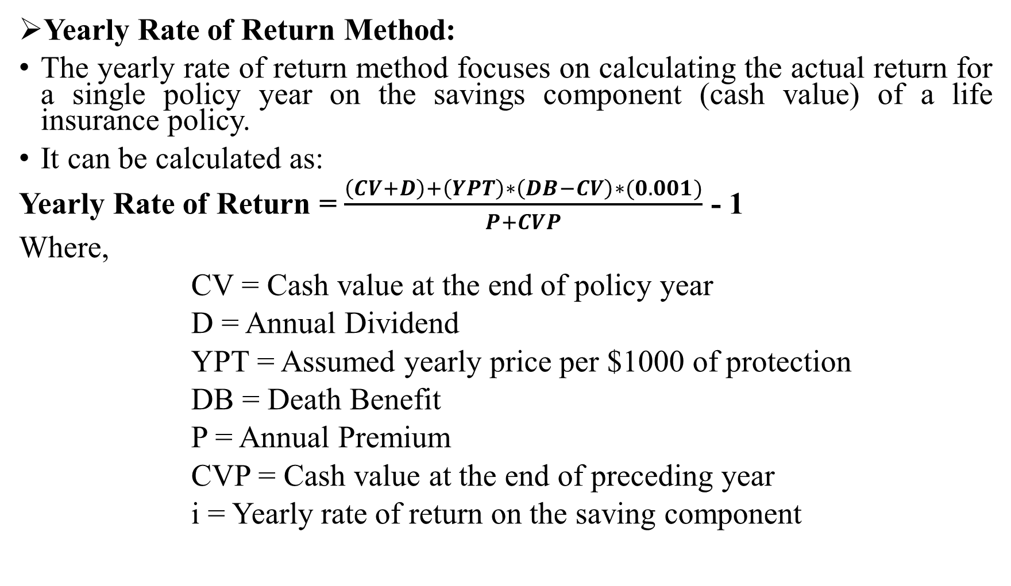
Yearly Rate of Return Method:
The yearly rate of return method focuses on calculating the actual return for a single policy year on the savings component (cash value) of a life insurance policy.
It can be calculated as:
Yearly Rate of Return = $\frac{\left(CV+D\right)+\left(YPT\right)∗\left(DB−CV\right)∗(0.001)}{P+CVP}$ - 1
Where,
CV = Cash value at the end of policy year
D = Annual Dividend
YPT = Assumed yearly price per $1000 of protection
DB = Death Benefit
P = Annual Premium
CVP = Cash value at the end of preceding year
i = Yearly rate of return on the saving component

Slide 58
For Example: Assume that Mark purchased a $100,000 participating ordinary life policy at age 35. He is now age 42 at the beginning of the eighth policy year. He would like to know the yearly rate of return on the saving component for the eighth year of the policy. The annual premium is $1500. The cash value in the policy is $7800 at the end of the seventh policy year and $9200 at the end of the eighth policy year. The eighth-year dividend is $400. Because Mark is age 42 at the beginning of the eighth policy year, the benchmark price is $4.00 per $1000. Based on the preceding information, calculate the yearly rate of return for the eighth policy year.
Given, Death Benefit (DB) = $100,000
Annual Premium (P) = $1500
Cash value at the end of policy year (CV) = $9200
Cash value at the end of preceding policy year (CVP) = $7800
Annual Dividend (D) = $400
Assumed yearly price per $1000 of protection (YPT) = $4.00
Yearly rate of return on the saving component (i) = ?

Slide 59
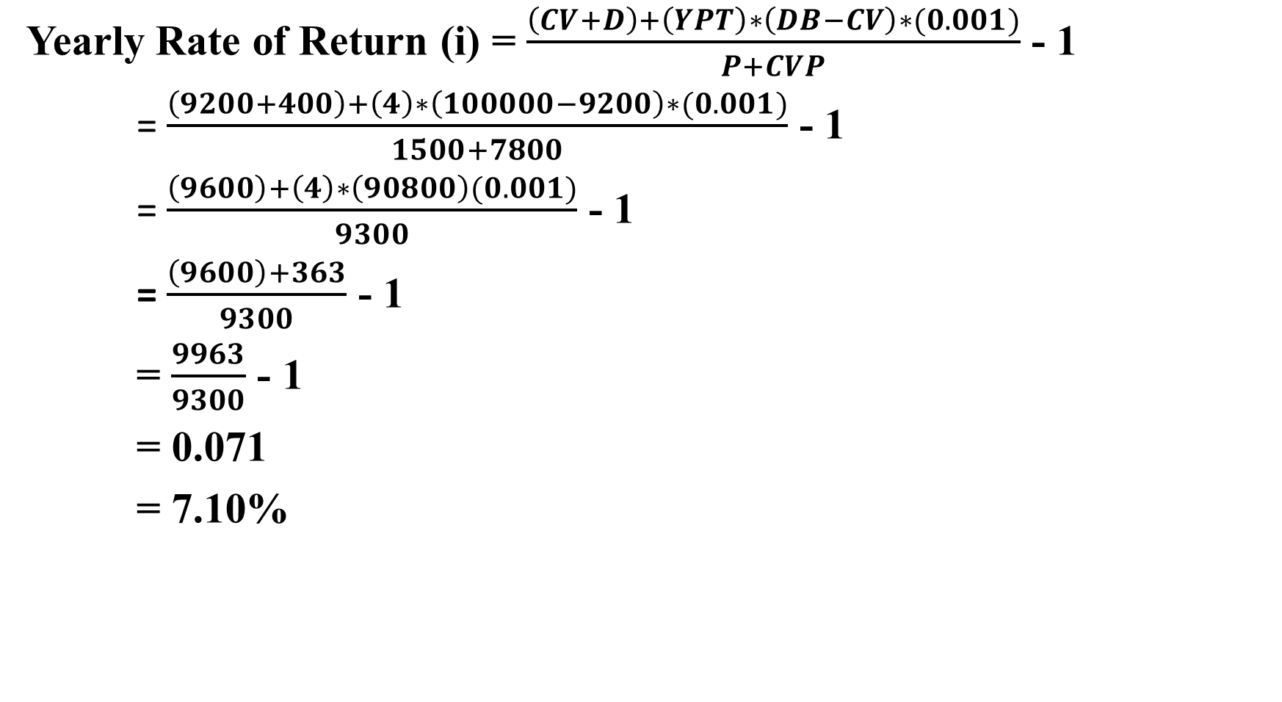
Yearly Rate of Return (i) = $\frac{\left(CV+D\right)+\left(YPT\right)∗\left(DB−CV\right)∗(0.001)}{P+CVP}$ - 1
= $\frac{\left(9200+400\right)+\left(4\right)∗\left(100000−9200\right)∗(0.001)}{1500+7800}$ - 1
= $\frac{\left(9600\right)+\left(4\right)∗\left(90800\right)(0.001)}{9300}$ - 1
= $\frac{\left(9600\right)+363}{9300}$ - 1
= $\frac{9963}{9300}$ - 1
= 0.071
= 7.10%

Slide 60
Taxation of Insurance Business
Taxation in insurance business includes all part of tax applicability and tax exemption. This includes:
Tax exemption: In case of Nepal, there is tax exemption on life insurance premium up to Rs.40,000 or actual premium paid by policyholder, whichever is lower and tax exemption on health insurance up to Rs. 20,000 or actual premium paid, whichever is lower.
Tax Deduction on Source (TDS) : Tax on maturity benefit is charged by 5% on capital gain (the amount received in excess of premium paid).
Tax exemption on death benefit: There is tax exemption on death benefit. No tax is applicable in any of the amount received as death benefit by the nominee of the policyholder.

Slide 61
Tax in the commission of the agent: Tax rate equal to 15% is charged on the commission earned by the agent of life and non life insurance.
Value Added Tax (VAT) : 13% VAT is charged by the insurance company to the policyholder on the amount of premium of all insurance products. However, VAT is exempted on the premium of agriculture and micro insurance.
Corporate Tax: Corporate tax on profit of insurance company is 30% for all kind of insurance company.
Service Charge: National Insurance Authority collects 1% service charge on the premium paid. Hence, insurance company collects the service charge along with the premium.

Slide 62
Shopping of life insurance
Shopping of life insurance means purchasing the life insurance necessary for you. To make the better purchase decision, this involves the 7 steps.
Determine whether you need life insurance: First you need to identify why you need an insurance? You might need substantial amount of life insurance if you have dependent to support, paying off debt, saving or whatever the reason, you need to identify.
Estimate the amount of life insurance you need: You can follow either the need approach, human value approach or the capital retention approach to estimate the amount. However, need approach is simple and practical.
Decide on the best type of life insurance for you: The best type is that, which meets your objectives of purchasing insurance. The objectives may be financial or safety. Based on the objective, you may purchase whole life, term life or an endowment life policy.

Slide 63
4. Decide whether you want a policy that pays dividends: participating insurance are better option such as stock insurers and mutual insurers that give policyholder the right to share on the income of the insurance company.
5. Shop around for a policy that provides good values: Make the cost and benefit analysis of the insurance policy you purchase Vs. the opportunity cost of purchasing the policy. Always purchase the policy having higher benefit than the cost of loosing opportunity.
6. Consider the financial strength of the insurer: In addition to the cost of insurance, you need to consider the financial health of the insurance company. You need to know the capital and reserve size, quality of investment portfolio, past profitability, management team along with the claim settlement history.
7. Deal with the professional agent: A professional agent is one who has the competence to understand your need for insurance such as financial planner, and to match them with the right plan.

Slide 64
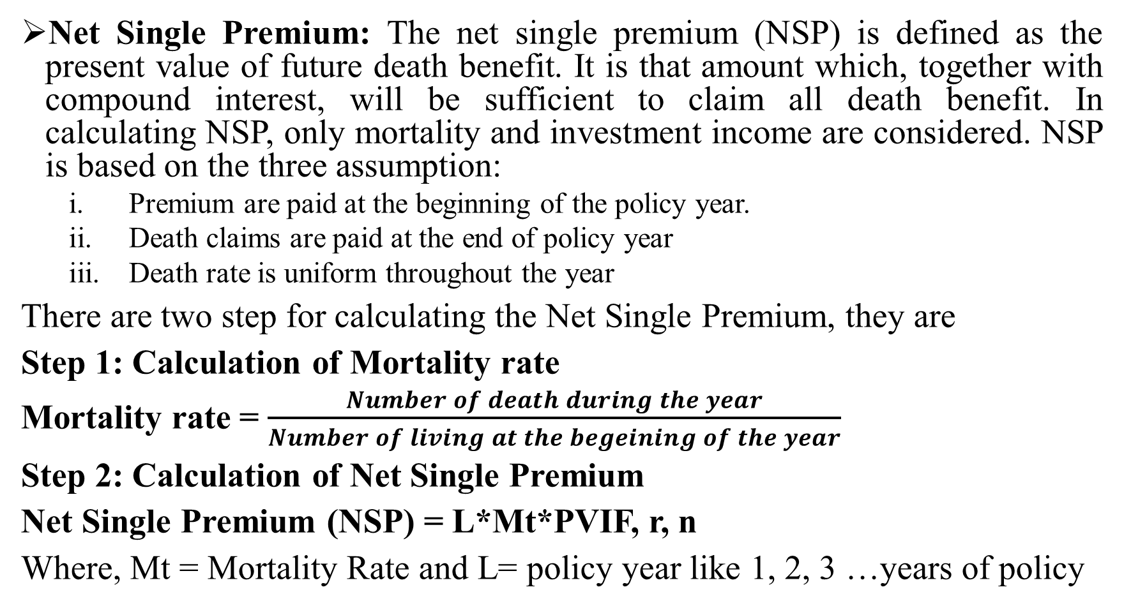
Calculation of Life insurance premium
Net Single Premium: The net single premium (NSP) is defined as the present value of future death benefit. It is that amount which, together with compound interest, will be sufficient to claim all death benefit. In calculating NSP, only mortality and investment income are considered. NSP is based on the three assumption:
Premium are paid at the beginning of the policy year.
Death claims are paid at the end of policy year
Death rate is uniform throughout the year
There are two step for calculating the Net Single Premium, they are
Step 1: Calculation of Mortality rate
Mortality rate = $\frac{Number of death during the year}{Number of living at the begeining of the year}$
Step 2: Calculation of Net Single Premium
Net Single Premium (NSP) = L*Mt*PVIF, r, n
Where, Mt = Mortality Rate and L= policy year like 1, 2, 3 …years of policy

Slide 65
For Example: Calculate the insurance premium for two year term insurance policy in the amount of Rs. 500,000 issued to a person aged 46 . Assume interest rate is 5% and consider the standard mortality table as follows:
Solution:
Age at Beginning | Beginning of Designated year | No. Dying during designated year
46 | 9,075,554 | 52,090
47 | 9,006,705 | 58,032
Age | Mortality Rate (Mt) | Amount of Insurance | PVIF,r,n | Insurance cost
1 | 2 | 3 | 4 | 5 = 2*3*4
46 (Year 1) | 52,090/9,075,554 | 500,000 | PVIF, 5%, 1 year = 0.9524 | 2733.1949
47 (Year 2) | 58,032/9,006,705 | 500,000 | PVIF, 5%, 2 year = 0.9070 | 2921.9911
 |  |  | Total | 5655.186

Slide 66
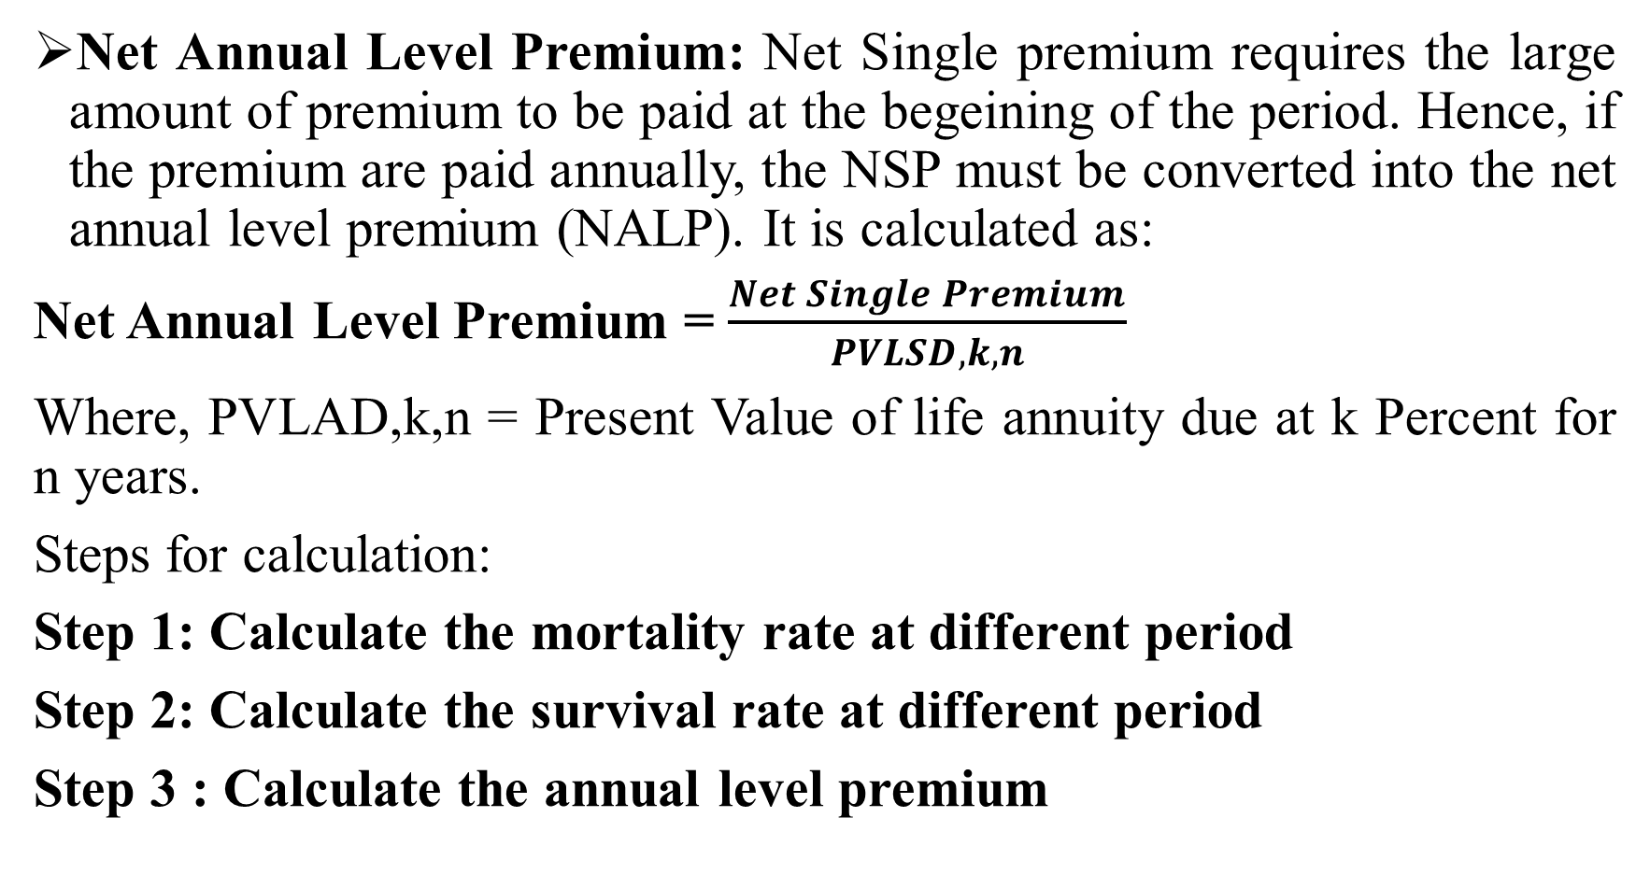
Net Annual Level Premium: Net Single premium requires the large amount of premium to be paid at the begeining of the period. Hence, if the premium are paid annually, the NSP must be converted into the net annual level premium (NALP). It is calculated as:
Net Annual Level Premium = $\frac{Net Single Premium}{PVLSD,k,n}$
Where, PVLAD,k,n = Present Value of life annuity due at k Percent for n years.
Steps for calculation:
Step 1: Calculate the mortality rate at different period
Step 2: Calculate the survival rate at different period
Step 3 : Calculate the annual level premium

Slide 67
For Example: Calculate the insurance premium for three year term insurance policy in the amount of Rs. 500,000 issued to a person aged 40 . Assume interest rate is 5% and consider the standard mortality table as follows:
Solution:
Step 1: Calculation of Net Single Premium
Age at Beginning | Beginning of Designated year | No. Dying during designated year
40 | 9,075,554 | 52,090
41 | 9,006,705 | 58,032
42 | 8,920,611 | 60,116
Age | Mortality rate (Mt) | Amount of In surance | PVIF,k,n | Insurance Cost
1 | 2 | 3 | 4 | 5 = 2*3*4
40 | 52090/9075554 | 500,000.00 | PVIF, 5%,1 year = 0.9524 | 2733.388
41 | 58032/9006705 | 500,000.00 | PVIF, 5%,2 year = 0.9070 | 2920.54
42 | 60116/8920611 | 500,000.00 | PVIF, 5%,3 year = 0.8638 | 2911.006
 |  |  | Total | 8564.93

Slide 68
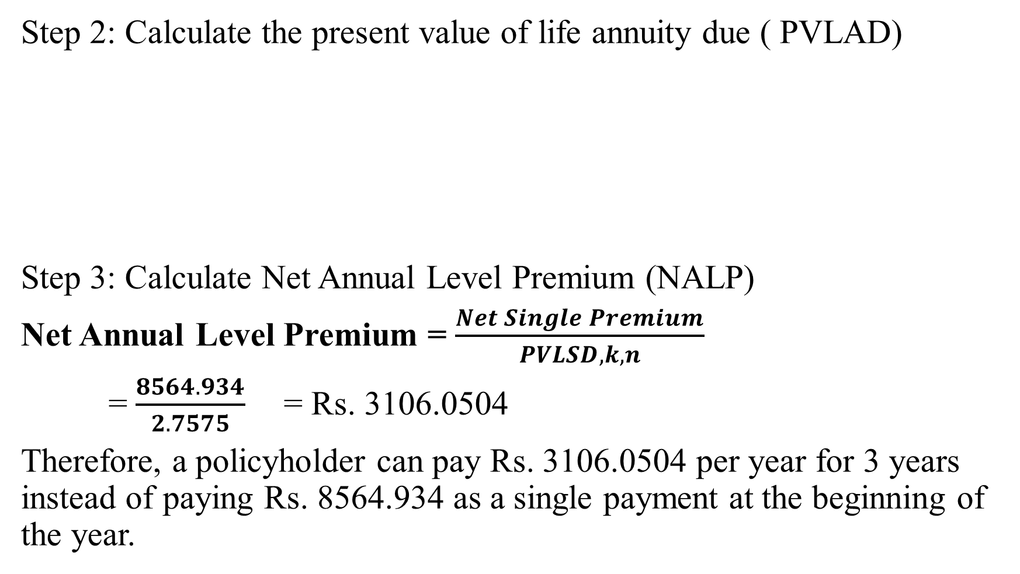
Step 2: Calculate the present value of life annuity due ( PVLAD)
Step 3: Calculate Net Annual Level Premium (NALP)
Net Annual Level Premium = $\frac{Net Single Premium}{PVLSD,k,n}$
= $\frac{8564.934}{2.7575}$ = Rs. 3106.0504
Therefore, a policyholder can pay Rs. 3106.0504 per year for 3 years instead of paying Rs. 8564.934 as a single payment at the beginning of the year.
Age | Survival rate | PVIF, k,n-1 | Product
I | II | III | IV = II*III
0 | 9075554/9075554=1 | PVIF, 5%,1-1 yrs = 1 | 1
1 | 9006705/9075554 = 0.9924 | PVIF,5%,2-1 yrs = 0.9524 | 0.9452
2 | 8920311/9075554 = 0.9829 | PVIF, 5%,3-1 yrs = 0.8264 | 0.8123
 |  | PVLAD | 2.7575

Slide 69
Progress of Life Insurance In Nepal
The life insurance in Nepal has made a significant progress over the past decades, evolving from small sector to a growing and competitive market.
The introduction of Nepal Life Insurance Company in 2001 and subsequent entry of multiple private insurers transformed the industry by increasing competition, innovation, and outreach.
Before the emergence of private life insurance companies, the insurance market is largely controlled by Rastriya Beema Sansthan, which had product limitation and poor geographical diversification.
However, with the establishment of Nepal Insurance Authority, it ahs strengthned the regulatory oversight and encouraged private sector participation.
Insurance companies now offers wide range of products including whole life, endowment life, money back, term insurance, micro insurance, foreign employment insurance – this helps to increase the access of life insurance in Nepal.

Slide 70
Current Status
There are 14 life insurance companies are in operation currently.
In FY 2024/25, life insurers in Nepal collected over NPR 154 billion in total premiums, showing healthy expansion of the sector.
Over the first 10 months of the same fiscal year, business grew by about 14.84 % compared to the previous year, with nearly 13.7 million policies sold.
Life insurers earned premiums across all seven provinces, with Bagmati and Lumbini seeing particularly strong business.
Nepal Life Insurance continues to lead in premium volumes, followed by National Life Insurance and LIC Nepal, reflecting established market positions.
Life insurance coverage of the population reached record levels (over 44 %), indicating broader public uptake, though significant gaps remain.

