Slide 1

Private Equity & Venture Capital Financing
Chapter : 05
nagendradhimal.com.np
FINANCIAL ANALYST

Slide 2

What is Private Equity?
Understanding the investment vehicle pooling capital from various sources
A Private Equity Fund is an investment vehicle that pools capital from high-net-worth individuals and institutional investors. Its primary goal is to create value and realize gains through structured exit strategies, enabling investors to benefit from successful investments over time.

Slide 3




Features of Private Equity
Liqudity
Private Investment
High Capital
Long-Term Investment
Provide the high liqudity
Funds raised privately, avoiding public markets.
Large-scale investments involved in funding ventures.
Investments typically held for several years.

Slide 4

Financing a Fledging
Financing a fledgling business means providing financial support to a newly established or early-stage company that is still in its development phase. A fledgling business is a young, inexperienced, and newly started enterprise that has high growth potential but lacks sufficient capital, operational history, and market stability.

Slide 5


Founders
Creators
Founders develop and lead the initial growth.
Leaders
They guide their teams towards business success.
Founders are individuals who start, establish, and organize a business. They generate the original idea or concept of the business. Founders take the initial risk, arrange early resources, and build the foundation of the company.

Slide 6
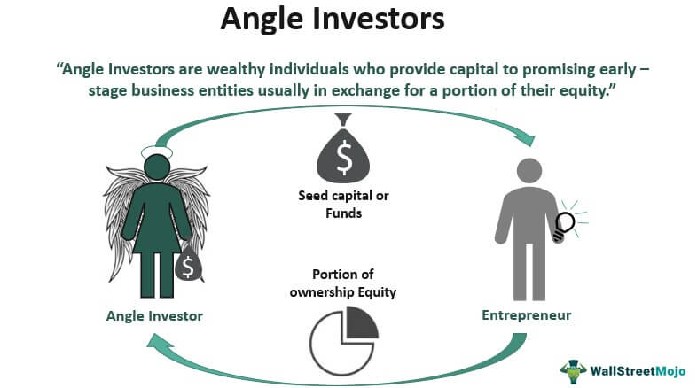

Angel Investors
Wealthy individuals providing early-stage funding and support.
Angel investors are wealthy individuals who invest their personal money in early-stage or newly established businesses. They provide financial support in exchange for equity ownership in the company.

Slide 7

Venture Capital
Venture Capital refers to long-term funds provided to new or fast-growing companies that have high growth potential but also high risk. Venture capital firms invest in innovative businesses, especially in technology and new industries.

Slide 8




Importance of Venture Capital
Innovative Financing
Promoting Innovation
Job Creation
Business Credibility
Supporting high-risk projects with potential growth
Encouraging technological advancements and new solutions
Generating employment opportunities through new ventures
Increasing trust and reputation in the market

Slide 9




Importance of Venture Capital
Long-term Financing
Economic Growth
Job Creation
Innovation
Supports sustained growth of businesses
Drives innovation and job creation
Ventures generate new employment opportunities
Fosters development of new technologies

Slide 10
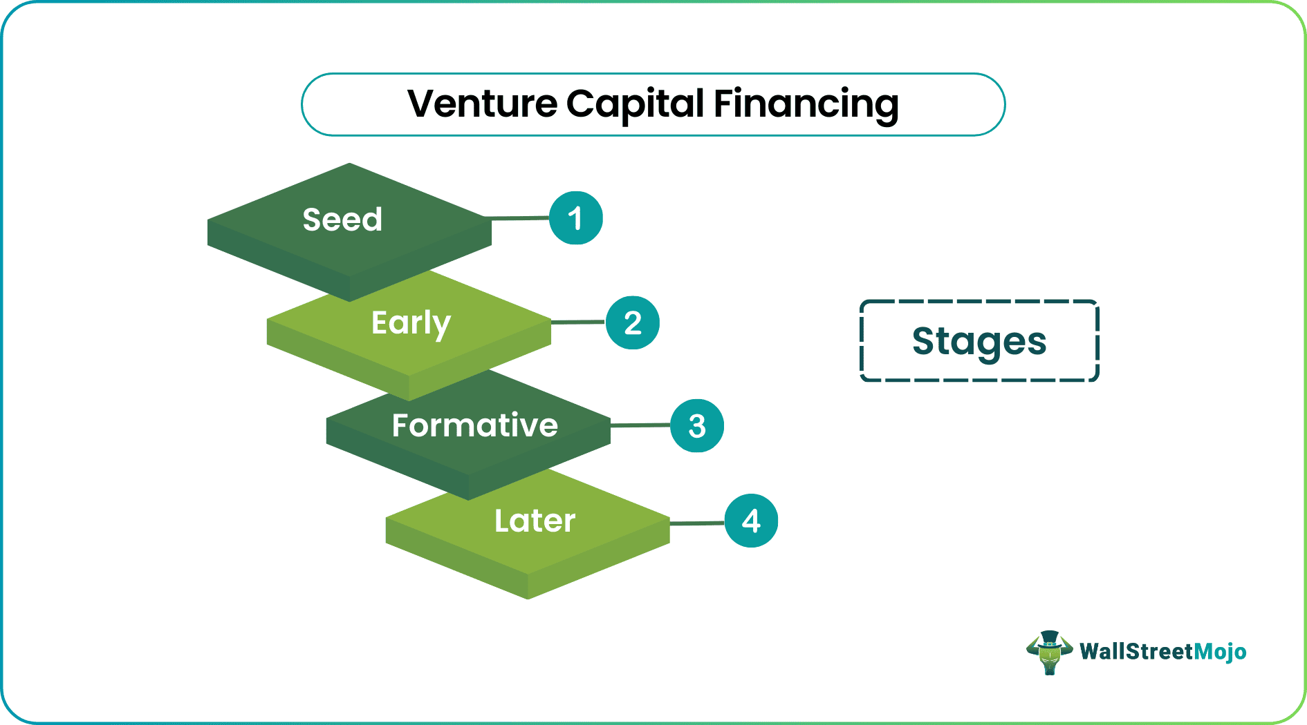
NDGURU

Slide 11



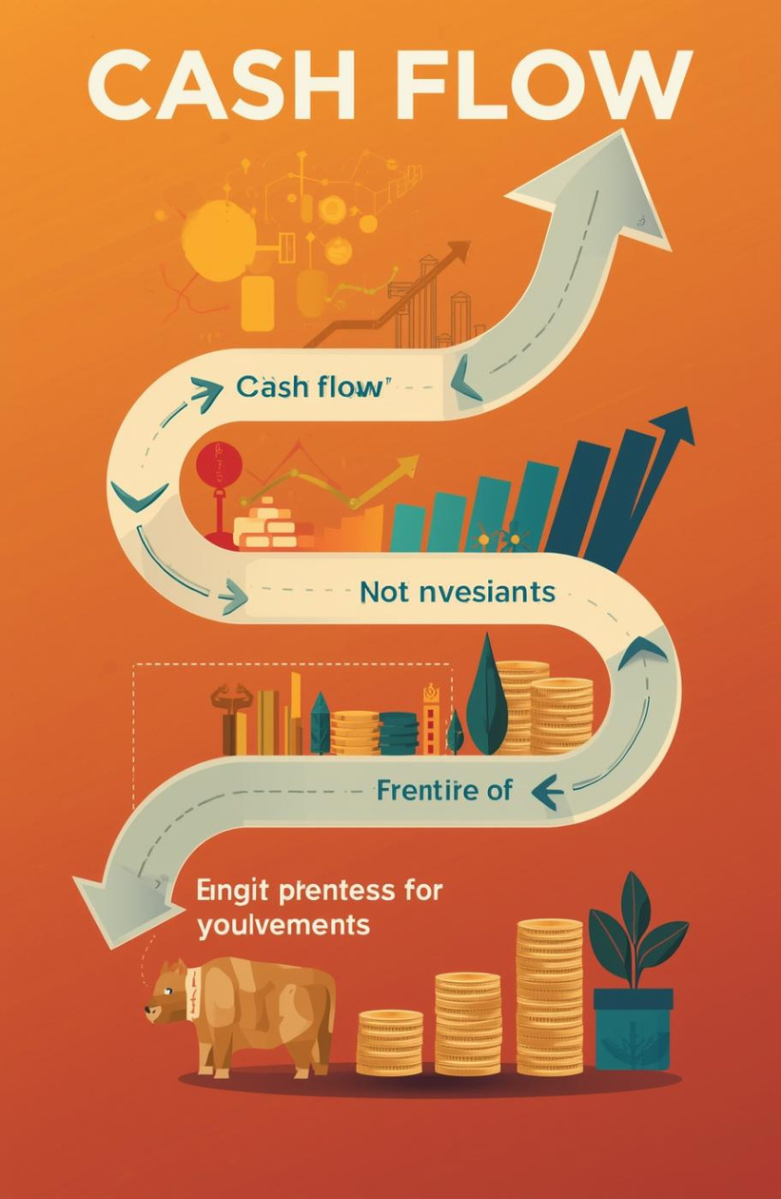

Seed Capital
Startup Financing
Second Round
Cash Flow
Investment Nurturing
Initial funding for market research and design
Funding to develop products and hire staff
Growth funding to expand the customer base
Visualizing increasing investments in business growth
Cultivating ideas for future business success
1– Early Stage

Slide 12




Expansion Financing
Replacement Capital
Management Buyout
Rescue Capital
Funding for new markets and product launches
Buying out existing shareholders for growth
Managers acquiring ownership of the business
Funding distressed firms to avoid bankruptcy
2– Later Stage

Slide 13
Chapter : 07
Financial Distress

Slide 14

What is Financial Distress?
Understanding the complexities of financial instability and its effects
Financial distress occurs when an individual or business struggles to meet financial obligations due to inadequate cash flow or overwhelming debt. This situation can lead to serious consequences, including bankruptcy and liquidation, ultimately jeopardizing business operations and affecting stakeholders. Recognizing these challenges is crucial for effective financial management.

Slide 15


Bankruptcy
Legal Declaration
Bankruptcy is a legal condition in which a person, business, or organization is unable to pay its debts when they become due. It is a formal declaration made through a court of law stating that the debtor does not have sufficient assets or cash flow to meet financial obligations.
Liquidation
Liquidation is the process of closing down a company by selling its assets and using the proceeds to pay off its debts and liabilities. After liquidation, the company permanently stops operating and its legal existence ends.

Slide 16
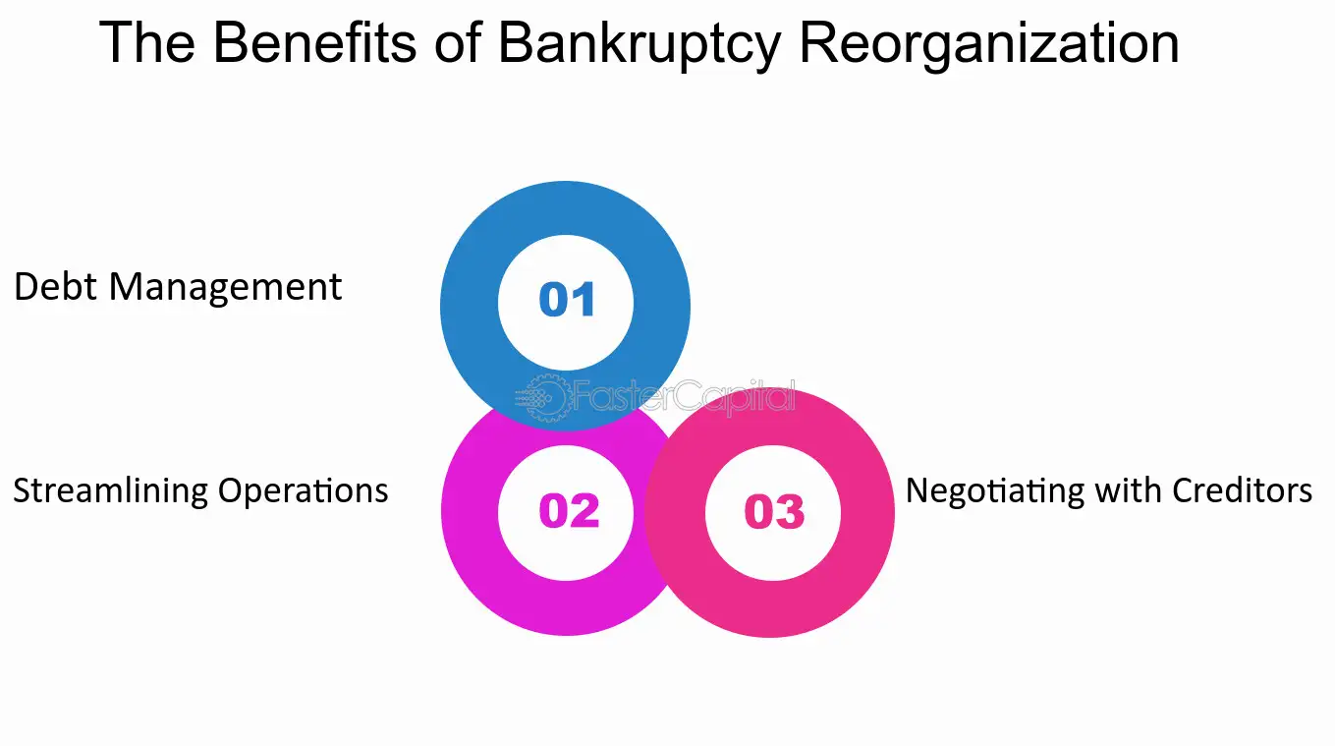

Bankruptcy Reorganization
Bankruptcy reorganization is a legal process through which a financially distressed company is allowed to continue its business operations while restructuring its debts under court supervision.

Slide 17


Going Private and leverage Buyout
Going Private
Going private refers to the process by which a publicly listed company converts itself into a private company by buying back its shares from public shareholders and removing (delisting) its shares from the stock exchange.
Leveraged Buyouts
A Leveraged Buyout (LBO) is the acquisition of a company using a large amount of borrowed funds (debt) and a small portion of the buyer’s own capital (equity).

Slide 18
WEBSITE
www.nagendradhimal.com.np
Thank you
Questions? We’d love to hear from you!
EMAIL
besure14@gmail.com
PHONE
9745862965

