Slide 1

NDGURU DIGITAL LEARNING PLATFORM
Most Important Chapter
Nagendra Dhimal

Slide 2





Welcome to
NDGURU Learning Space
Visit Website to Get complete Notes
nagendradhimal.com.np

Slide 3

Grammar - 15
Visit : nagendradhimal.com.np
Unit -1 Facts
Noun & Pronoun
Subject Verb Agreement
Tens
Modifier
Adjective and Adverb
3 Marks

Slide 4



Q no 2
Connector
Preposition
Conjunction

Slide 5


Q No 3
Mechanics
Pattern
Punctuation
Capatilization
Pattern Types

Slide 6


Unit-2
Business Language
Q No 4
Language & Meaning
Function of Language
For Online Classes
Cohorent Paragarph
9745862965
Confused Word
nagendradhimal.com.np

Slide 7
Vocabulary
Unit- 03
Q no- 05
Business Terminologies
Idioms and Expression
Importance Of BV
Way to Improve BV

Slide 8



Our Online Class Features
EveryDay Live Classes
Notes & Recording Video
Expert Guidance
100% Garuntee Pass
9745862965

Slide 9


Unit- 04
Nonverbal Messages
Business Communication Massages
Electronic Messages
Visual Messages
Oral Messages
-5 Marks
Written Messages

Slide 10
Unit-5
15 Marks
Business Writing
For - 5
For-10
Instruction
Memo
News Report
Press Realse
Advertisment
Media Story
Brochure
Notice
Articles

Slide 11
Unit-06
Writing Process
Drafting and Revising
Note Making
Summarizing
Editng and Proff Reading
Invention
Q no 9 to Q no 12

Slide 12
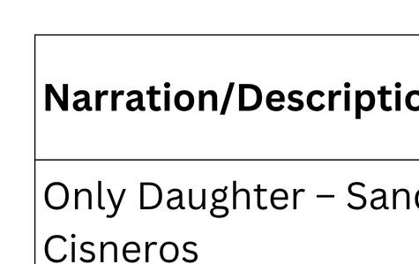
Unit-07
Patterns of Writing

Slide 13






Thank You
Follow Us
NDGURU
NDGURU
NDGURU

