Slide 1
Class 12 English
यति पढे सबै पास
All Chapters in one shot
Social Media Links
TikTok: NDGURU
YouTube: NDGURU
Website: nagendradhimal.com.np
Facebook: Nagendra Dhimal
WhatsApp: 9745862965
Follow Us

Slide 2

Includes Content
1. Story 2. Poem
3. One-Act Play 4. Essay
5. Free Writing 6. Grammar
7. Vocabulary

Slide 3
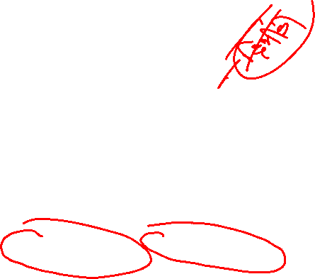
Story
1. Neighbor – Tim Wistom
The story “Neighbours” by Tim Winston demonstrates how immigrants may contribute to Australia’s social fabric. Their strong sense of community aids the couple in seeing that intolerance, prejudice, and discrimination all comes from a lack of knowledge. Neighbours is a story about a newly married couple living in a multicultural and multilingual suburb neighbourhood. It shows that cultural and linguistic barriers cannot stop people from bestowing love and compassion.
Important Questions
a. What does the 'fractured dialogue' mean in the story?
ANS:- In Tim Winton's short story "Neighbours," the term "fractured dialogue" likely refers to the challenges and difficulties in communication and understanding that arise between characters due to cultural and linguistic differences. The story explores how misunderstandings can arise when individuals from different backgrounds interact, creating a sense of disconnect in their conversations

Slide 4
How Did the neighbor respond about women pregnancy?
➜ The neighbours responded to the woman’s pregnancy by smiling tirelessly. The man in the deli gave her small presents of chocolates and him packets of cigarettes. In the summer, Italian women began to offer names. Greek women stopped the young woman in the street, pulled her skirt up and felt her belly, telling her it was bound to be a boy. By late summer the woman next door had knitted the baby a suit, complete with booties and beanie and the Polish widower next door had almost finished his two-car garage.
c.Why did the young man began to cry at the end of story ?
The young man began to weep at the end of the story because he was greatly touched by the help of neighbours which he didn’t expect due to the human feelings of neighbours towards them.
d. Why the author does not mention the any character in this play?
➜ I think the author didn’t characterize the persons in the story with proper names because he wants to generalize the case not to a specific person but also to every person who is culturally and linguistically from a different society. So the writer makes the couple for the universal character and he tries to share his idea that in the neighbourhood, humanity remains even after having different languages and cultural norms.
Other Questions
1. Describe the character of young man
2. Describe the feeling of young couple when they first arrived at new place

Slide 5
A Respectable Women- Kate Chopin
Summary
Character and Role:
Mrs. Baroda: A complex protagonist who battles personal desire and societal expectations.
Gouvernail: A calm, introspective visitor who unintentionally challenges Mrs. Baroda’s moral boundaries.
Gaston Baroda: Her trusting husband, unaware of her internal struggle.
In Kate Chopin’s A Respectable Woman, Mrs. Baroda experiences inner conflict as she finds herself unexpectedly attracted to her husband’s friend, Gouvernail. Initially disappointed by his visit, she slowly grows fond of his calm demeanor. Despite her attraction, she resists temptation, upholding her role as a “respectable woman.” After Gouvernail leaves, she decides to confront and control her emotions. When her husband later proposes another visit from Gouvernail, she agrees, claiming to have “overcome everything.”
Theme:
The story explores inner conflict, temptation, societal norms, gender expectations, and the idea of self-restraint in the name of respectability and reputation.
Important Question
1. Mrs Board told her husband she had overcome everythings. What do you think she had overcome?
2. How was governial different from Mrs Borada thinking ?
3. Why was Mrs boarda unhappy when knew about the visit of Gournial in their farm?

Slide 6
A Devoted Son- Anita Desai
Summary
Characters:
Rakesh: A devoted, disciplined son and doctor.
Mr. Varma: Rakesh’s proud but later frustrated father.
Veena: Rakesh’s supportive wife.
A Devoted Son by Anita Desai portrays the story of Rakesh, a brilliant and obedient son from a poor Indian family. After excelling in medical school and studying in the U.S., he returns home, rejects a prestigious job, and serves his parents and country. He marries a village girl, opens a clinic, and takes care of his aging father, Mr. Varma. However, conflicts arise when Rakesh restricts his father’s diet for health reasons. Mr. Varma feels oppressed and longs for freedom, eventually preferring death over his son's strict care.
Important Question
Justify the title A Devoted Son?
How did the community celebrate Rakesh Success?
Describe how Rakesh start his career ?

Slide 7
The Treasure in the Forest – H.G walls
Characters: Evans and Hooker, two British treasure hunters
Themes: (greed, danger, betrayal, and the consequences of unchecked ambition
Summary
In H.G. Wells’ short story, two Englishmen, Evans and Hooker, steal a treasure map from a murdered Chinaman named Chang-hi. The map leads them to an island where treasure from a Spanish shipwreck is buried. As they carry the gold across the island, Evans becomes weak and collapses. Hooker, while rearranging the gold, is pricked by a thorn. He recalls strange markings on the map and realizes too late that they indicate the presence of poisoned thorns used by the native Dyak tribe. The story ends with both men dying, victims of their greed and ignorance of the land’s dangers.
Important Question
Interpret the story treasure in the forest as mystery story
How did Evan and Hooker know about the treasure?
What is your opinion is the moral of story?

Slide 8
My Old Home –Lu xun
Character: Characters: Lu Xun, Runtu, Hong’er, Shu Sheng, Lu’s mother, Mrs Yang.
Summary
In Lu Xun’s My Old Home, the narrator revisits his childhood home after twenty years and finds it worn down, reflecting the harsh changes in life and society. He reunites with his childhood friend Runtu, recalling their joyful bond. However, Runtu now treats him with formal respect, revealing the deep-rooted class differences shaped by time and hardship. This shift shatters Lu Xun’s belief in their past equality. The story highlights nostalgia, lost innocence, and the social divide that alters human connections. Lu Xun hopes future generations, like his nephew
and Runtu’s son, can form friendships free of such barriers.
Theme: Nostalgia, social class division, childhood innocence, lost friendship, and the impact of societal roles on human relationships.
Important Questions
How does the writer describe his felling at arrival of his home?
Why does the author rush to come back home after may years
Do you think relationship of childhood are innocent, impartial and immature?

Slide 9
The Half Close Eyes of The Buddha Slowey Sinking The sun- Sankar Lamichhane
Character:
Lady Tourist – Foreign visitor with interest in Eastern culture.
Guide – Local Nepali, spiritually insightful and culturally aware.
Child – Minor character, represents innocence and future generations.
Summary :
The Half-Closed Eyes of the Buddha and the Slowly Sinking Sun by Shankar Lamichhane is a philosophical and descriptive short story set in Kathmandu, Nepal. The narrative unfolds through a conversation between a foreign lady tourist and a local Nepali guide, both acting as narrators. While the tourist claims expertise in Eastern culture, the guide subtly asserts his deeper understanding. Through their dialogue, the story explores Nepal’s cultural richness, historical depth, and spiritual beauty. The guide narrates legends such as that of Manjushri, who created the Kathmandu Valley by cutting through Chobhar, and highlights the Buddhist values seen in monks and nuns spreading compassion and purity. He paints vivid imagery of the valley, equating the beauty of the terraced fields and mountains to the serene, half-closed eyes of the Buddha, reflecting the slowly setting sun. The story celebrates the harmony of nature, history, and spirituality, subtly critiquing superficial understandings of deep cultural traditions.
Theme: The story explores themes of cultural pride, East-West contrast, spirituality, inner wisdom versus surface knowledge, and the harmonious connection between nature, myth, and human understanding.

Slide 10
A Very Old Man with Enormous Wings- Gabriel Garcia Marquezt
Character:
Pelayo: Elisenda’s husband who discovered the old man. Pelayo was an ordinary villager.
Elisenda: Pelayo’s wife who convinced him to charge villagers to see the old man.
Father Gonzaga: The priest of the village and an authority figure in the community.
The Neighbor Woman: A neighbor of Pelayo and Elisenda who claimed the old man was an angel.
The Spider Woman: A strange woman with the body of a giant spider and the head of a sad young girl, who attracted more attention than the old man
Theme
"A Very Old Man with Enormous Wings", a magical realist story published in the year 1955, written by Colombian writer Gabriel Garcia Marquez. It examines the human response to those who are weak, dependent, and different. The story has shown human nature-related curiosity, greed and cruelty.
Summary
"A Very Old Man with Enormous Wings" by Gabriel García Márquez is a tale of magical realism that explores human reactions to the strange and different. During a storm, Pelayo and Elisenda discover a weak, winged old man, believed to be an angel. They imprison him and charge visitors to see him, exploiting his presence for profit. Despite being mistreated and misunderstood, the old man remains passive. Interest fades when a Spider Woman arrives with a more relatable story. Eventually, the old man regains strength and flies away. The story highlights themes of cruelty, curiosity, and the loss of wonder.

Slide 11




Poem Section:
A Day – Emily Dickisons
Summary:
Emily Dickinson’s “A Day” uses vivid imagery to describe the journey from sunrise to sunset, symbolizing the transition from innocence to experience or from life to death. The poem captures how the rising sun awakens the world and how sunset quietly brings an end to the day, possibly hinting at the mystery of death. The speaker observes the day’s changes through the innocent eyes of a child, reflecting the wonder and eventual understanding of life’s cycle.
Key Symbols:
Sunrise – Birth, innocence, joy.
• Birds flying – Freedom, happiness.
• nset – Death, experience, mystery.
• Darkness – The unknown, confusion, or the end of life.
Important Questions
How does the poet describe the morning sun in the first stanza?
IS the speaker watching the morning sun ?why?why not ?

Slide 12


Every Morning I wake – Dylan Thomas
Summary
"Every Morning I Wake" is a reflective and devotional poem extracted from Dylan Thomas’s 1954 radio play Under Milk Wood. The poem serves as a humble prayer from a human being—fragile, mortal, and aware of his limitations—to a magnificent and powerful God. The speaker acknowledges that humans are small, temporary creatures, born only to die, yet they carry deep faith and devotion. Every morning, the speaker wakes up and prays not just for himself, but for all living beings under Milk Wood, seeking God's mercy and grace. Through this heartfelt prayer, Thomas emphasizes the spiritual connection between humanity and the divine, and glorifies God’s greatness and compassion over the lives of ordinary people.
Imporant Questions
Explain the following lines from the poem ‘Every morning I wake ‘with reference to the contex.
We are not wholly bad or good
who lives our under milk wood
And thou I know ,wilt be the first
TO see our best side ,not our worst
2. DO you agree of disagree with the poets impression about the magnificence of the god?

Slide 13
I was Own My Route – Juila de Burgos
Summary
The speaker Julia de Burgos, a radical feminist, challenges the masculine concept of defining a female’s existence and journey via traditional paths in the poem “I Was My Own Route.” She links male mentality to gender inequality and male prejudices towards women.
Women’s own freedom and liberation are portrayed in this poem. Above all, the poem teaches us the moral that men and women are both members of the same society, and they both require freedom, liberty, independence, and other aspects of life, and they should be permitted to pursue their own paths rather than those dictated by patriarchal society.
Important Questions
Explain the following line with references to the context
At each advancing step on my route forward
My back was ripped by the desperate flapping wings
Of the old guard
2. Why did the speaker try to be the way men wanted her to be?

Slide 14
The awakening age- Ben Okri
In the poem “The Awakening Age,” the poet Ben Okri depicts the struggles of African people and offers a demand for unity, peace, and solidarity among human beings from all over the world. This poem depicts how Nigerians have suffered a long history of starvation, poverty, unemployment, and conflicts (ethnic, religious, political, terrorism, militancy, electoral, and so on) that have rendered them a vulnerable community. Northern Nigeria has been oppressing the Igho group, which has resulted in ethnoreligious conflict. The poem depicts the narrative of a people whose optimism binds them together like glue, even though they are led by invisible powers.
Important Questions
Who are the people travel trough meridian line?
What does the poet mean new world?
How are people benefited by new people

Slide 15
Soft Strom- Abhi Subedi
"Soft Storm" by Abhi Subedi is a free verse poem that reflects the chaos and contradictions of modern Nepali society with a tone of compassion and hope. The speaker takes a night walk through the streets of Kathmandu, observing social and environmental disorder, indifference, and injustice. In the beginning, the poet uses images of natural beauty like crocuses blooming and the moon, contrasted with scenes of poverty, homelessness, and political corruption.
He criticizes societal malpractices, showing orphans begging in Thamel, violent acts, and silenced voices of the oppressed. Despite the turmoil, he finds hope in nature and yearns for a peaceful world where people live in harmony. The poem ends with the speaker’s plea for freedom and a desire to return to a natural, loving world.
Symbols: represent chaos, innocence, silence, oppression, nature’s beauty, and hope—contrasting society’s darkness with a longing for peace.
Questions
What do you understate by ”this seamless city”
Describe the poor children portrayed in the poem

Slide 16

" Marriage as a social institution "
– Steven L. Nock (March 11, 1950 – January 26, 2008)
Marriage is the union of two spouses who are bound by legal, moral, and traditional obligations and have a variety of deep personal bonds and social links. It is a structured framework that integrates with other institutions such as family, education, economy, law, and politics. In many ways, the connection between couples is governed by rules, and they exist inside soft borders to follow the patterns. Marriage is distinguished from all other types of partnerships by its soft boundaries or permitted bounds of behaviour.
Marriage is a legally and socially recognized union offering structure, commitment, and emotional stability, especially for men. It is guided by moral and traditional norms. In contrast, unmarried cohabitation offers freedom without societal acceptance or legal backing, lacking the structured responsibilities, identity, and protections that define and support traditional marriage.
Important Questions
Do you think marriage as social institution why or why not?
According to author what is marriage
Discuss the six dimension of normative marriage in America
Ans: Heterosexuality, Monogamy, Lifelong Commitment, Sexual Fidelity Shared Residence Parenthood

Slide 17
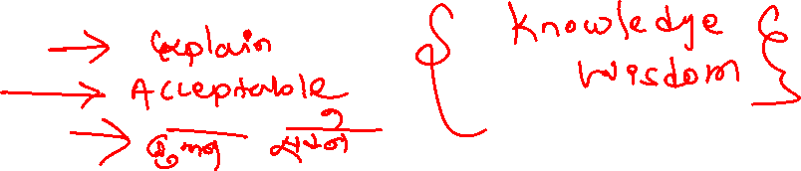
Knowledge and Wisdom -Bertrand Russel
Understanding text
In this essay, “knowledge and wisdom”, the writer defines knowledge and explained the different ways of acquiring it.Russell distinguishes between knowledge and wisdom in this essay. Wisdom and knowledge are not the same things. He defines knowledge as the gathering of data and information, whereas wisdom is the practical application and use of knowledge to produce value. Not simply memory, but also study and actual experience, leads to wisdom.
Components
Comprehensiveness
Proposnality
Human understanding
Important Questions
Different between knowledge and wisdom
Can wisdom is be taught? If so, how
What are factor that contribute wisdom

Slide 18



Humility –Yuval Noah Harari
Yuval Noah Harari, a well-known essayist from Jerusalem, wrote the essay Humility. In this essay, he displays humility by debunking humanity’s illusions of superiority and mastery. Morality, art, spirituality, and creativity, he says, are universal human talents encoded in our DNA(Deoxyribonucieic acid). In the essay, Humility, Yuval Noah Harari exemplifies the virtue of humility in that he debunks humanity’s illusions of superiority and mastery. He claims morality, art, spirituality and creativity are universal human abilities embedded in our DNA.
Important Question
The author has dealt with a controversial debate on human history. Why do you think history has been a major contested issue in the present world?
What, according to the essay, are the universal human abilities?

Slide 19
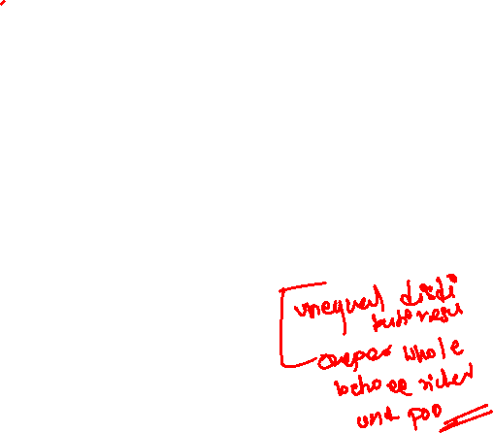
Human Rights and the Age of Inequality-Samuel Moyan
In “Human Rights and the Age of Inequality,” Samuel Moyn deals with the drastic mismatch between the egalitarian crisis and the human rights remedy that demands not a substitute but a supplement. He points out that the human rights regime and movement are simply not equipped to challenge global inequalities.
To connect the history of human rights with the history of economics, he says that there are two main steps to do:
The first was the heroic era of national welfare states after World War II.
Second, in the 1940s, politics and economics took over the country.
Important question
What is the goal of the Universal Declaration of Human Rights?
Why is the Universal Declaration of Human Rights important to you?

Slide 20

On libraries- Oliver Sacks
"On Libraries" is a personal and heartfelt essay by Oliver Sacks celebrating the joy of reading, intellectual freedom, and the lasting value of physical books. Growing up surrounded by books in his family library, Sacks was deeply influenced by literature and science. His parents, both lovers of books, kept collections of medical, literary, and poetic works. As a lifelong bookworm, he found solace and inspiration in libraries. He was disheartened in the 1990s when libraries began discarding physical books in favor of digital access, calling it a loss of wisdom and culture. Sacks believed that digital texts could never replace the delight and inspiration of printed books. A medical book, Megrim (1873), first sparked his writing journey.
Important Question
Why was the author biased towards science
Why did he dislike his school ?

Slide 21

One Act and play Section
The Bull – Bhimnidhi Tiwari
Character
Laxminarayan: doctor of bull and pandit
Jitman: Cowherd
Gore : Cowherd
Ranabahadur: Grandson of Prithivi Narayan shah
Male: The bull
Summary of the Play: Famous Nepali author Bhimnidhi Tiwari wrote the one-act play "The Bull," which dramatizes a story about Ranabahadur Shah's obsession with bulls and is a biting satire on the feudal system of the mid-18th century, which dehumanizes people to the point where their survival depends on their deference . “The Bull” powerfully depicts the feudal system of the time, in which ordinary people were oppressed, dominated, and dehumanized. The animals of feudal lords deserved greater respect than the animals of commoners. It explores the dehumanization of common people by rulers, the enslavement of Lords/Kings’ servants, and the domination of the higher classes.
Important questions
How does the play make a satire on the feudal system?
Discuss the late eighteenth-century Nepali society as portrayed in terms of the relation between the king and his subjects as portrayed in the play

Slide 22
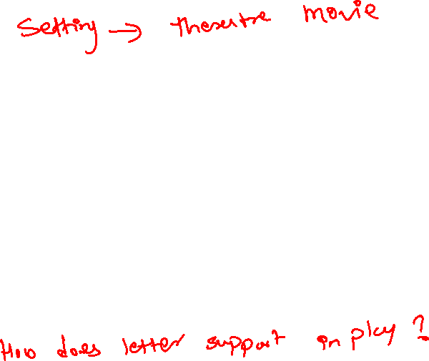
A Matter of Husband –Feren Monlar
Character
Earnest young women: wife
Alfred - Husband of earnest young women
Famous actress – love affair with Alfred
Summary
A Matter of Husbands by Ferenc Molnár is a clever one-act play that explores themes of trust, deception, and perception in relationships. The play tells the story of an earnest young woman who confronts a famous actress, believing her husband, Alfred—a lawyer—is having an affair with her. However, the actress skillfully manipulates the conversation, convincing the young woman that it was only a ploy to make her husband more desirable. The play ends with a twist, leaving the audience questioning the truth. It highlights how appearances can be deceiving and warns readers not to easily trust others, especially in matters of love.
Important Question
Briefly describe about the impression to the famous actress?
What does play the letter in a play

Slide 23

Facing the Death- August Strindberg
Character
Mr Durand - old man, dele- 27 years old ( whose wife die several year ago) – Jethi Xori, Annette- 24 years , Therese- 24 years , Antinio – therese ( Boyfriend)
Setting:
Mr Durand his own home of one dying room
Remember things
Facing Death, a one-act play by August Strindberg tells the story of Monsieur Durand, a former railroad worker and widower in financial ruin. Durand has three daughters, Adèle, Annette, and Thérèse, who have no future prospects. Despite his efforts to provide for his children, including renting out his home to lodgers, he has been received with ridicule and derision.
How our parents do scarify their whole life to provide the happiness for the children without having any wealth. But the children are not responsible towards the parents because the mordanity brings to the children unethical and exploitation when we grow up elder . Also the drama show the how money impact in the relationship of people.
Understanding Question
1. "Money determines the relationship between characters in this play.’ Elaborate this statement with examples from the play.
2. Discuss Facing Death as a modern tragedy.
3. How does Monsieur Duran die

Slide 24
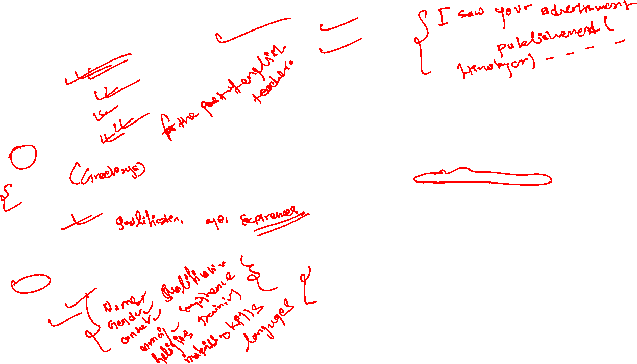
Job Application-8 marks
Free Writing Sections
Job Application Letter
address sender
Date (7th march, 2023)
To the manager (post)
Nepal Telecom (office name)
Babarmahal, Kathmandu
Subject: maximum 6 words minimum 4 words( For the post of English teacher)
Dear sir/madam,
With references to the advertisement published (Himalayan times) on the March 9, 2023. I would like to apply for the post of …(subject matter) in your (office name).
Main body …
I submitted all my documents along with this application and if you give chance to serve in your (office name) i can work very hardly and honestly in your ( office name).
I am looking forward positive response in your side.
Faithfully
Name of sender
Bio data
Thamel Kathmandu
Date : 12th April
To The director
Abc College
Nayabaneshower Kathamndu
Subject : For the Post of English Teacher
Dear sir/ madam
With references to the advertisement published Himalayan times on the March 9, 2023. I would like to apply for the post of IT officer your metropolis city of Kathmandu. ( peres…. Subj + has/ have + V3 + object)
I am 25 years old young energetic personality and well qualified for the given post as Nepali citizen holders. I have completed my bachelor level with IT( Information Technology) faculty in 2020 from Nepal commerce campus. Similarly I have worked since 2020 to 2021 in Advance IT software company for the post officer. I have taken 2 years certificated for the training of IT communication and computer programming along with Advance computer graphics.
I submitted all my documents along with this application and if you give chance to serve in your metropolis i can work very hardly and honestly in your office.
I am looking forward positive response in your side.
faithfully

Slide 25
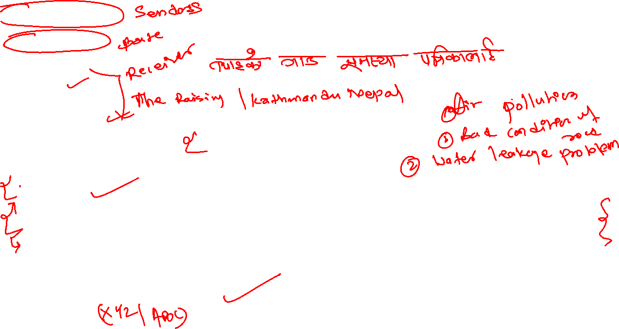

Letter to Editor- 8 marks
Janakpur, Dhanusha
6th March, 2023
To
The Editor
The Himalayan Times
Kathmandu, Nepal
Subject: Increasing Air Pollution in Kathmandu
Dear Sir/Madam,
Through the column of your esteemed newspaper, I would like to draw the attention of the concerned authority towards the growing issue of air pollution in Kathmandu.
In recent years, the air quality in Kathmandu has significantly deteriorated. Thick smog, dust from roads, vehicle emissions, and unmanaged construction activities have made it difficult for people to breathe clean air. Many residents, including children and the elderly, are suffering from respiratory problems. The lack of proper regulation, insufficient greenery, and the increasing number of vehicles on the road are contributing factors.
If immediate actions are not taken, the situation will worsen, leading to severe health crises and long-term environmental damage. The concerned authorities should enforce pollution control laws, promote green transportation, and increase public awareness about eco-friendly practices.
It will be good if you publish this in your newspaper, and the concerned authorities will see the gravity of this matter and some measures will be adopted to reduce air pollution in Kathmandu.
Sincerely,
Nagendra Dhimal

Slide 26
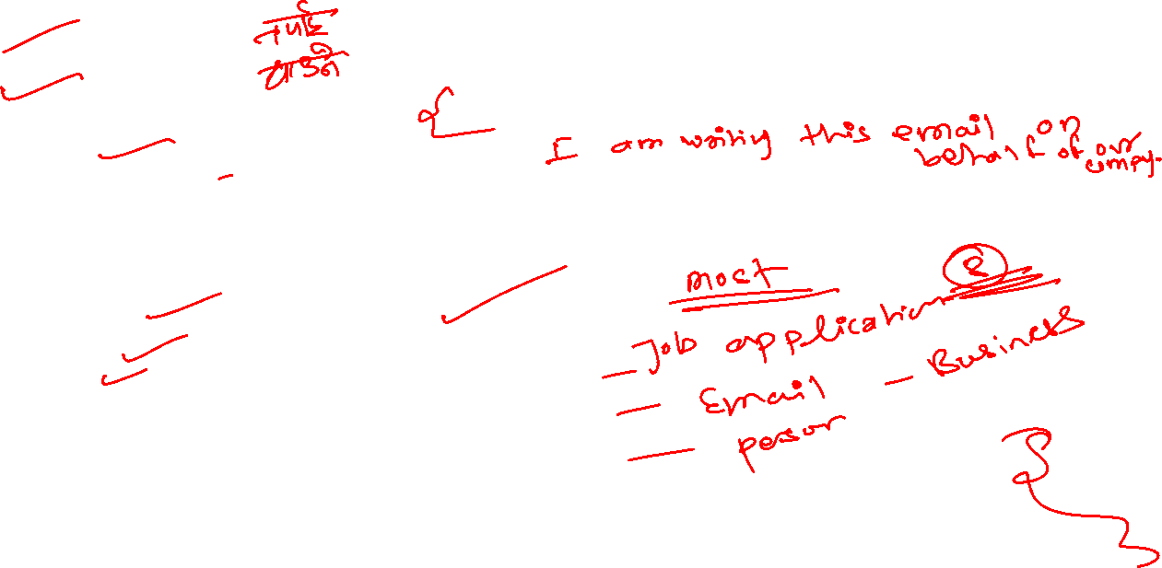
Email Writing-8 marks
From: Abc@gmail.com
To: Recipient’s email ID
Subject: Revised Working Hours
Dear Team,
Our company is growing, and there is a good inflow of projects every week. This has been possible with your dedicated and timely teamwork. In order to keep up with this, we have decided that the working hours would be advanced by 30 minutes. The revised time would be 8:30 am to 5 pm. This will be in effect from July 5, 2021 (Monday). It would be appreciated if all of you keep up with the timing and abide by it.
Feel free to come up with suggestions, if any queries.
Warm regards,
ABC Company
manager
Practice Questions
- Write an email to your school principal requesting permission to organize a science exhibition.
Include details such as date, venue, purpose, and expected participants.
- Draft an email to a book publisher requesting information about bulk purchase discounts for academic books.
- Imagine you missed an important online class. Write an email to your subject teacher apologizing and requesting a summary or recording of the class.

Slide 27
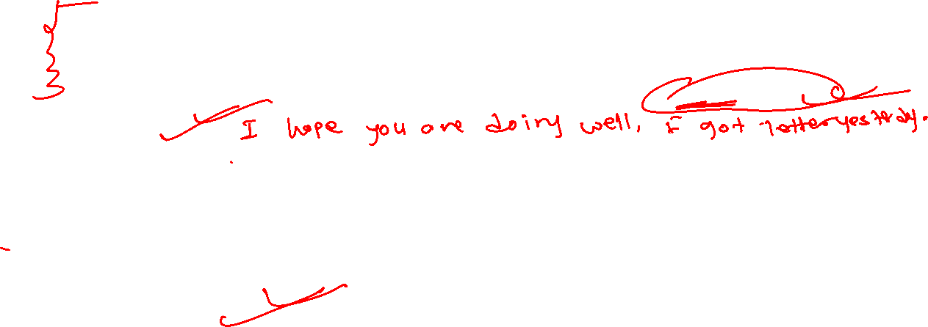
Personal Letter- 8 marks
Date: 17th jun,2025
Dear [Friend's Name],
I hope you're doing well. I just wanted to share how my exam preparation is going. These days, I’m fully focused on my studies. I’ve created a proper timetable and am trying my best to stick to it. I usually start my day early with a quick revision of what I studied the day before. Right now, I’m giving extra attention to difficult subjects like [insert subject], while also revising easier ones regularly. Solving past question papers and taking short notes has really helped me understand the important topics. I also use online videos whenever I get stuck or need a different explanation. Studying in short sessions with breaks in between has kept me more focused and less tired.
I’ve reduced distractions like social media and spend most of my time with books these days. It’s not easy, and sometimes I feel stressed, but I remind myself that all this effort will be worth it. Staying positive is key. I miss our regular talks, but once exams are over, we’ll definitely catch up. I hope your preparation is also going well. Let’s both do our best and aim high!
With warm regards,
[Your Name]

Slide 28
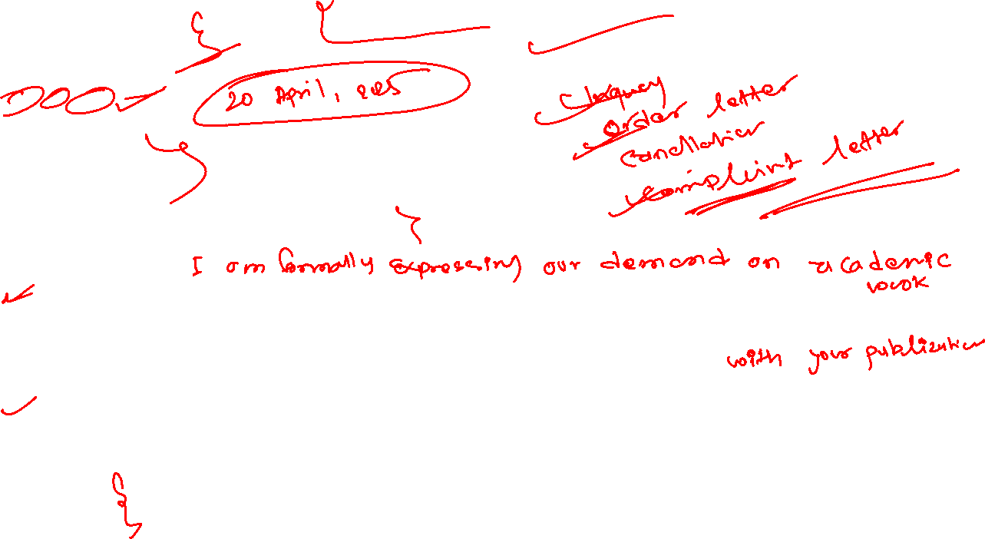
Business Letter- 8 Marks ABC Bookstore New Road, Kathmandu April 20, 2025 The Manager Everest Publications Putalisadak, Kathmandu Subject: Request for Quotation of Academic Books Dear Sir/Madam, We are one of the leading bookstores in New Road, Kathmandu. We are planning to purchase a large number of academic books for the new academic session. We are especially interested in textbooks for Classes 11 and 12, covering all major streams such as Science, Management, Humanities, and Education. Kindly send us your latest catalog and the price list of your published books. Please mention any discounts on bulk purchases and the delivery time. Also include information about special packages, teacher guides, or reference materials. We plan to order soon. Thank you.Thank you for your cooperation. We look forward to your prompt reply. Sincerely, [Your Name] Manager ABC Bookstore

Slide 29
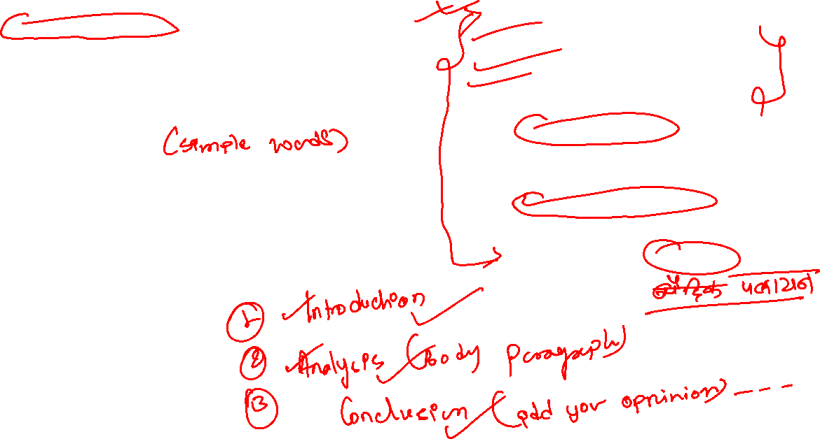
Essay Writing – 10 marks
1. Understand the Topic
Read the question carefully and make sure you know what to write about.
2. Make a Simple Outline
Plan your essay with three parts: Introduction, Body, and Conclusion.
3. Use Clear Language
Write in simple and correct English. Avoid long and confusing sentences.
4. Check and Revise
After writing, check for grammar, spelling, and sentence mistakes. Make improvements if needed.
5. Conclusion and Summary Writing
"
Important Topics Education Agriculture Vocational based university course Measurement of pollution Growth of population Aging situation in the society Unemployment of Nepal Computer use in education Environment pollution in Nepal Globalization and "brain drain

Slide 30
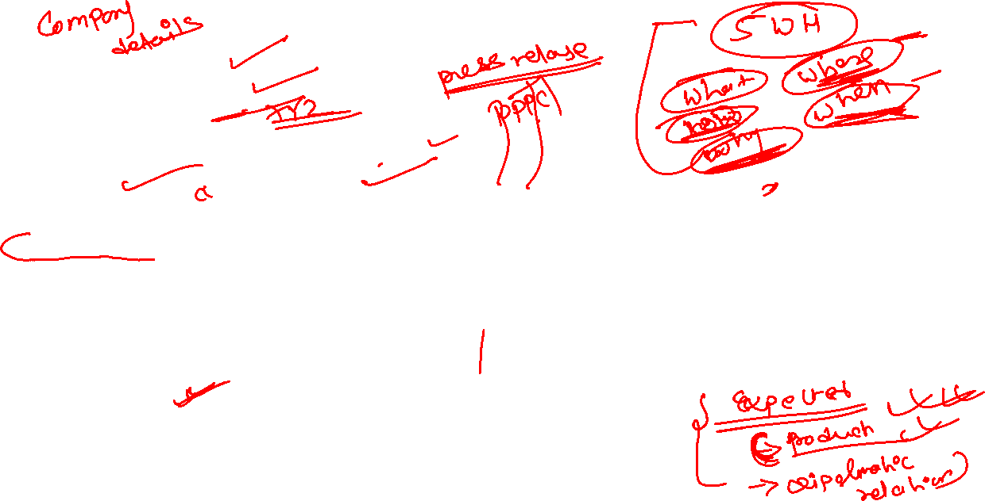
Press Release- 10 Marks Nepal Airlines Corporation Kantipath, Kathmandu, Nepal Contact: Nagendra Dhimal Tel: +977-1-(4220757, 4248614, 4244055, 4248617) Email: info@nac.com.np | Website: nepalairlines.com.np ALL FLIGHTS TO MOUNTAIN AREAS CANCELLED DUE TO BAD WEATHER KATHMANDU, Jan 18, 2022 – Nepal Airlines Corporation has cancelled all flights to the mountainous regions due to poor weather conditions, especially heavy fog and low visibility (under 2000 meters). Flights to Pokhara, Lukla, Ramechhap, Jomsom, Dolpa, Bajura, Simikot, Jumla, Langtang, Manang, Rolpa, Shyangboche, Tumlingtar, Baglung, Baitadi, Darchula, Dhorpatan, and Jiri are cancelled today. As per the Meteorological Forecasting Division, the thick fog is expected to last throughout the day. We deeply regret the inconvenience and request our valued passengers to remain patient. Flights will resume as soon as the weather improves. Passenger safety is our top priority, and we are working hard to provide better service. XYZ Managing Director Nepal Airlines Corporation

Slide 31
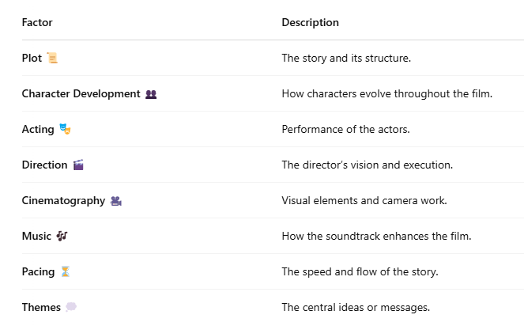
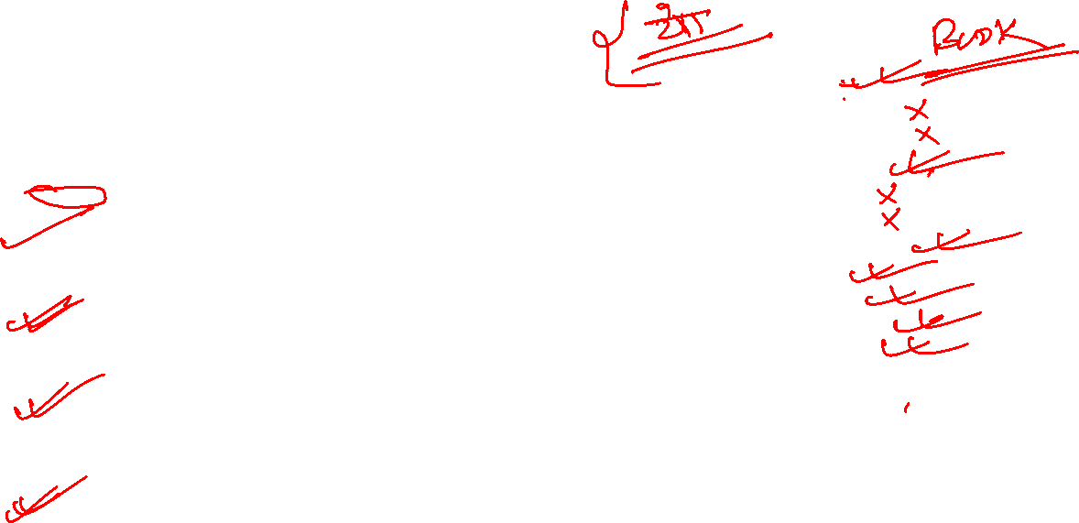
Movie Reviews- 10 marks
Introduction:
Muna Madan is a poignant Nepali film that explores the sacrifices of love and the challenges of life. Directed by [Director’s Name], this film brings to life the timeless story of Muna and Madan, based on the classic Nepali poem by Laxmi Prasad Devkota. The movie beautifully captures the essence of love, pain, and loss, intertwined with the cultural backdrop of Nepal.
Summary:
Muna Madan tells the tragic love story of Muna and Madan. Madan, a young man, leaves his wife, Muna, to earn a living in Lhasa, only to face the ultimate consequences. The film portrays Muna's unwavering love and devotion, leading to heartbreaking outcomes.
Strengths:
The film excels in its emotional depth, bringing out powerful performances. The scenic beauty of Nepal, along with the heartfelt music, enhances the storytelling. The portrayal of love and sacrifice is beautifully executed.
Weaknesses:
At times, the pacing feels slow, which may test the patience of some viewers. Certain emotional scenes could have been more subtle rather than overly dramatic, making them feel less impactful.
Recommendation and Conclusion
Muna Madan is a must-watch for lovers of classic Nepali literature and those who enjoy deeply emotional, character-driven stories. It’s a moving portrayal of love and sacrifice. Muna Madan is a tragic love story about Madan’s sacrifice and Muna’s unwavering devotion, set against Nepal’s cultural backdrop.
Title Directed by: Produced by Written by: Script by music by: Release date staring Country language Budget

Slide 32

For 5 marks Paragraph Writing
Tips for writes
Plan before you write.
Use simple and clear language.
Revise and proofread
Example “Use of Social Media” Social media has revolutionized the way we communicate and share information. It connects people globally, making it easier to stay in touch with friends and family. It also provides a platform for learning, as students can join educational groups, access tutorials, and even attend online classes. Social media helps in networking, building professional connections, and sharing ideas, which can lead to opportunities in various fields. Additionally, it enables quick dissemination of news and awareness about social causes. However, social media has its drawbacks. Overuse can lead to addiction, reducing productivity and affecting mental health. Constant exposure to idealized lives on platforms can result in feelings of inadequacy and anxiety. There is also the risk of misinformation, as false news can spread rapidly, leading to confusion and misunderstanding. Privacy concerns are another issue, as personal data may be misused or exposed. Therefore, it’s crucial to use social media wisely, balancing its benefits with its potential harms.
Important Topics The Importance of Education The Role of Social Media in Modern Society Benefits of Reading Book The Impact of Technology on Our Lives The Importance of Time Management The Role of Youth in Nation Building Environmental Pollution and Its Effects The Significance of Sports in Student Life

Slide 33
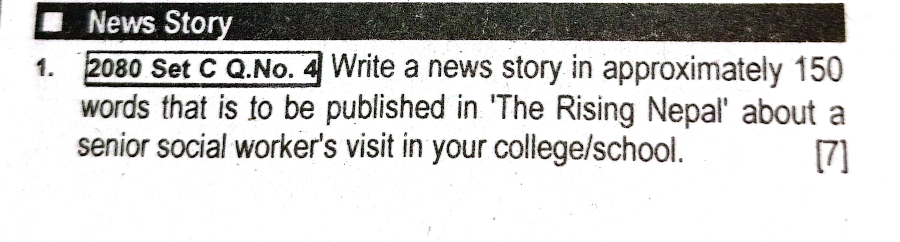

Writing Format Headline Lead (Introductory Paragraph) Body (Details and Conclusion)
“Senior Social Worker Visits XYZ College, Inspires Students”
The Raising Nepal
Kathmandu, March 10 – A senior social worker, Ms. Shanta Sharma, visited XYZ College on Thursday and delivered an inspiring speech to the students and faculty. The program was organized by the Social Awareness Club of the college with the aim of encouraging youth participation in social service.
Ms. Sharma, who has worked in the field of social welfare for over 25 years, shared her experiences of working with marginalized communities, women empowerment, and disaster relief. She encouraged students to be compassionate and to actively engage in solving social issues.
During the interactive session, students asked various questions related to social work, volunteering, and career opportunities in the field. The principal of the college, Mr. Ramesh Adhikari, thanked Ms. Sharma for her motivating presence and expressed hope that her visit would leave a lasting impact on the students.

Slide 34
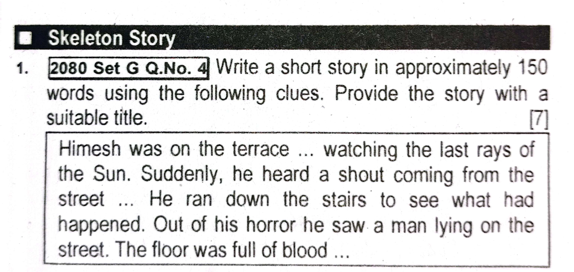

Writing Tips ✍️ Give a suitable title 🧠 Follow the clues creatively 📏 Keep it around 150 words 🪜 Maintain a clear beginning, middle, and end 🔍 Add a twist or conclusion
“ A Terrifying Evening”
Himesh was on the terrace, watching the last rays of the sun slowly disappear behind the hills. The sky was painted in shades of orange and red. Suddenly, he heard a loud shout coming from the street below. Alarmed, he rushed down the stairs to see what had happened.
To his horror, he saw a man lying motionless on the street. The floor was full of blood, and a small crowd had gathered around the scene. Some people were panicking, while others tried calling for help. Himesh immediately dialed the police and an ambulance.
Within minutes, the police arrived and secured the area. The injured man was taken to the hospital. Later, it was discovered that he had been attacked by an unknown assailant during a robbery attempt. The police assured the public they would find the culprit soon.
That evening left a deep impression on Himesh, reminding him how unpredictable life can be.

Slide 35
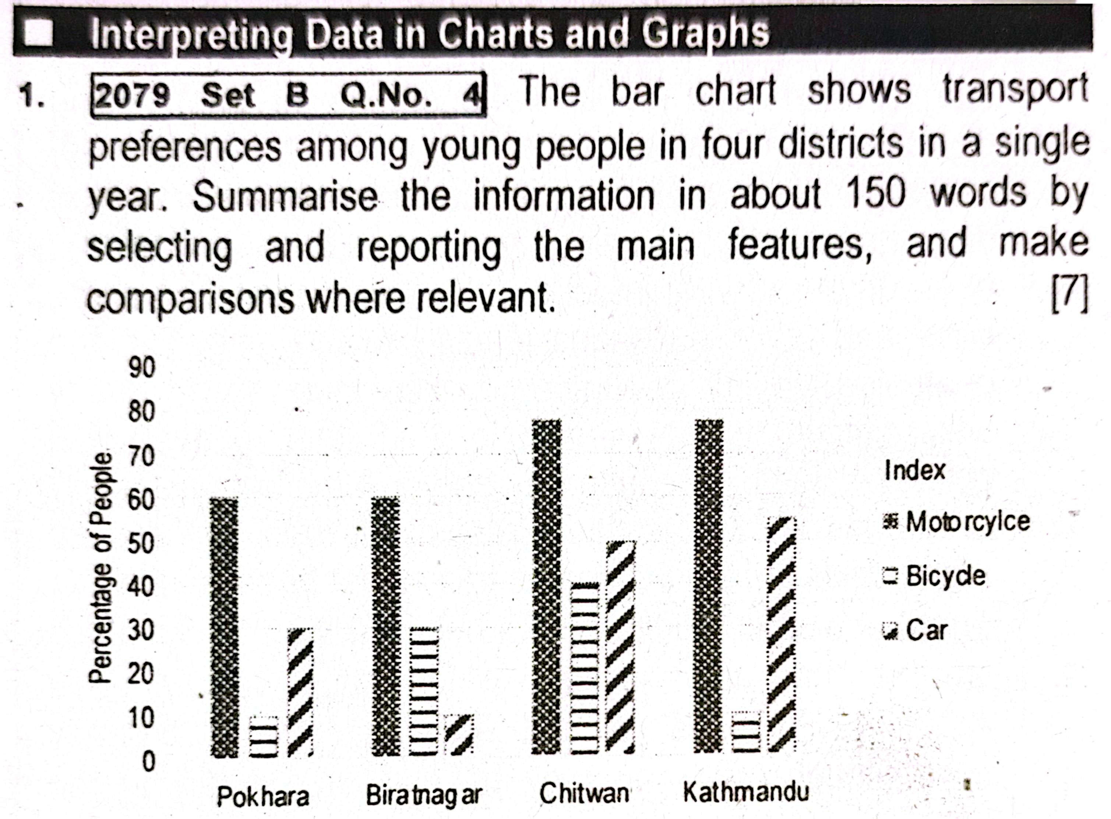

The bar diagram shows the transport choices of young people in four districts: Pokhara, Biratnagar, Chitwan, and Kathmandu. Three types of vehicles are shown: motorcycles, bicycles, and cars.
Motorcycles are the most popular in all districts. Kathmandu and Chitwan have the highest number of motorcycle users, while Pokhara and Biratnagar have slightly fewer. In Chitwan, many young people also use bicycles, but in Kathmandu, very few do. Cars are used the most in Kathmandu and the least in Pokhara and Biratnagar.
In conclusion, most young people like to use motorcycles. Bicycles are more common in Chitwan, and cars are more popular in Kathmandu. The chart helps us understand how transport choices are different in different places.
Tips 📊 Begin with what the chart shows (topic + location + time) 🔢 Compare the highest and lowest values clearly 📈 Use data to support your summary (approx. percentages) ✍️ Keep it within 150 words 📚 Use comparative words like more than, less than, highest, lowest

Slide 36
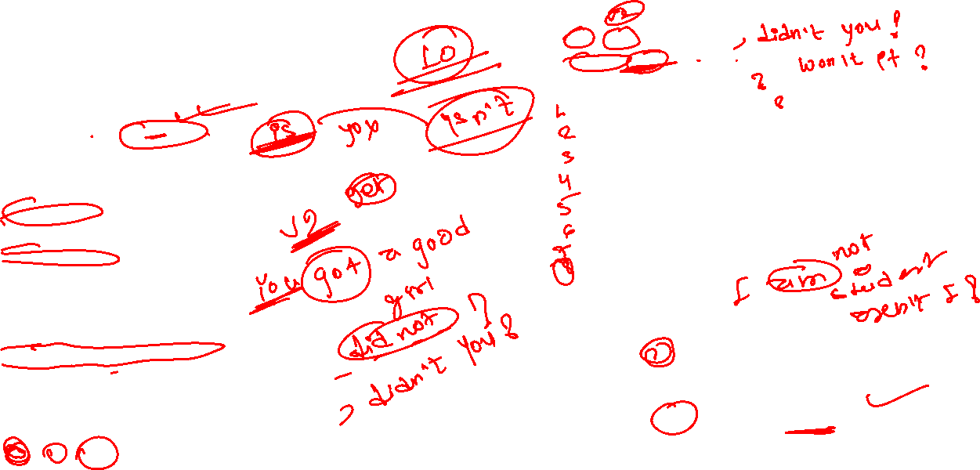
Grammar Part Question Tag General Rules If question positive = answer negative if negative = positive Using term is/am/ are / was/were/do/did/does/will/shall/should/would/has/have/had/may/might/must Had + better = had + subject had+ v1= would + subject have + rather= would+ subject is+v4=is subject am + verb = am + subject have+ verb = have + subject had + v3 = had + subject had+have+ v3= would + subject is + object= is + subject is + v3 = has + subject will/shall + verb = shall/will + subject If sentences V2 = did/didn’t V1= do /don’t+subjet V5 = does/ doesn’t
Practice Question You got my letter, …? The bus will stop here… …? You don’t smoke,……? I am not so fat as you…..? He did not come to school… ..? You haven’t taken your meal… …? She is gone ,…….? Have another cigarette…. ? have you ever go to pokharara……? Let me go now… …? Rita had to cook……? Some Special Case If Question Is ( S+ am + positive) = Use aren’t ….. If Question is ( S+not + am = use only am ……) If Question has let’s ------ Use shall we Other Case use ------------use Will You Example Let’s us go now , shall we? Let me sit down, will you?

Slide 37
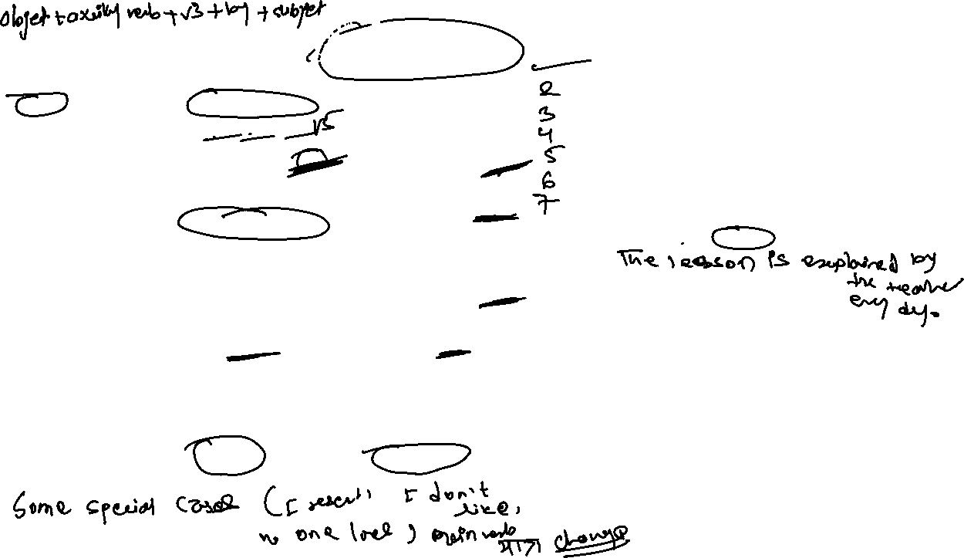

Practice Question Nobody called me last week. ( change into passive) I was not called last week./ I was called by no one last week. Help me ( change into passive) let me be helped Open the door. – Let the door be opened. Where are you going now? ( change into ) Where are being gone by you? Active: The teacher explains the lesson every day. Passive: _______________________________ Active: They have repaired the car. Passive: _______________________________ Active: Someone will finish the work tomorrow. Passive: _______________________________ Active: The company is launching a new product next month. Passive: _______________________________ Active: She had already written the email before the meeting. Passive: _______________________________
Passive Voice – Fix Question
Tense | Active Form | Passive Form
Present Simple | V1 / do / does | Is / am / are + V3
Present Continuous | Is / am / are + V4 (ing form) | Is / am / are + being + V3
Present Perfect | Has / have + V3 | Has / have + been + V3
Past Simple | V2 / did | Was / were + V3
Past Continuous | Was / were + V4 (ing form) | Was / were + being + V3
Past Perfect | Had + V3 | Had + been + V3
Future Simple | Shall / will | Shall / will + be + V3
Future Perfect | Shall / will + have + V3 | Shall / will + have + been + V3
Infinitive | To + V1 | To be + V3

Slide 38
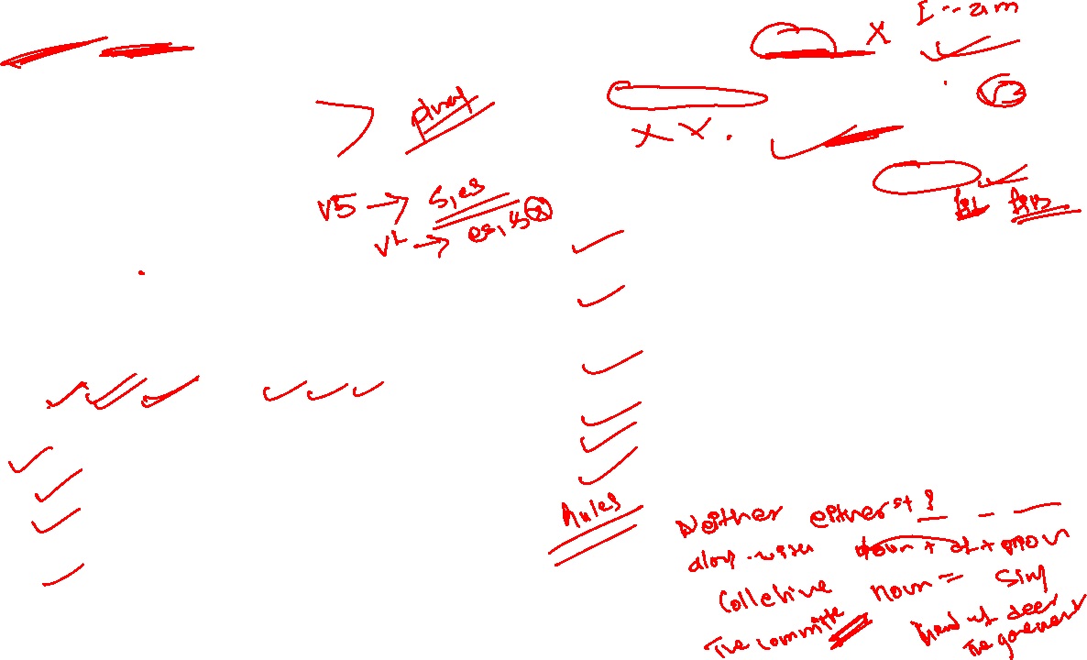
Subject Verb Agreement- 1 marks (fix)
Some magical Words
I /we/they/you- Plural subject ( pronoun)
Practice Question 1. Nor gas neither heaters …..(is/am/are) suitable for room heating ( choose the appropriate verb) 2. The principle along with other expert …..(has/have/were/was) present at meeting ( choose the verb) 3. Neither the tracksuit nor the pajamas …(fit) me. ( put the correct verb) 4. The herd of deer …..(run/runs) to the river. ( choose the correct option from the brackets) 5. The master along with his three servents …. (is/am/are) going to court. ( choose the appropriate verb from brackects) 6. Nither the manager nor the employees …. (was/were) available for moments. ( choose the appropartive verb) 7. The pairs of shoes …(look/looks) new. 8. The dollars …..(is/am/are) not enough to buy my books. 9. A group of tourists…. (was/were) taking picture.
Person | Pronoun/ noun
1st | I, We
2nd | You
3rd | He, She, It, Name, They
Singulars ( he, she, it, or uncountable) | Plural verbs( they, you, we, and countable
V5 ( goes, eats, comes etc) Is Was Has Does Will/ shall | V1 ( go, eat, come etc) Are/ am ( I = am) You=are Were Have Do Shall / will

Slide 39
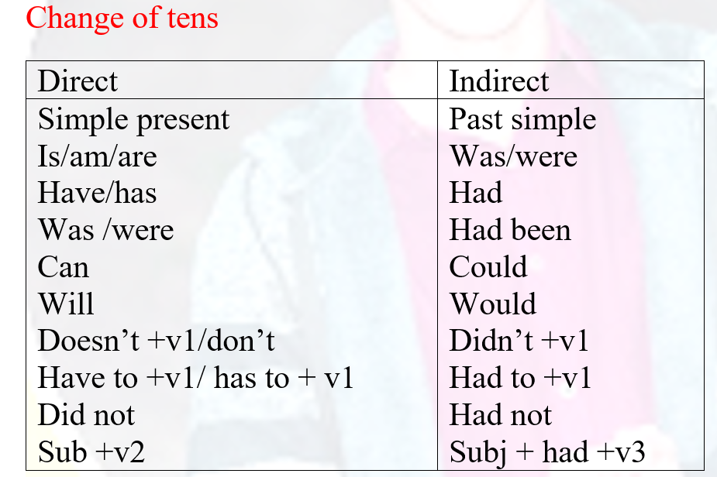
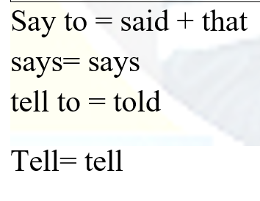
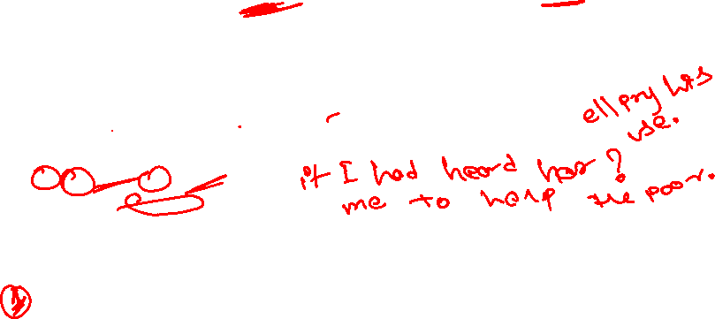

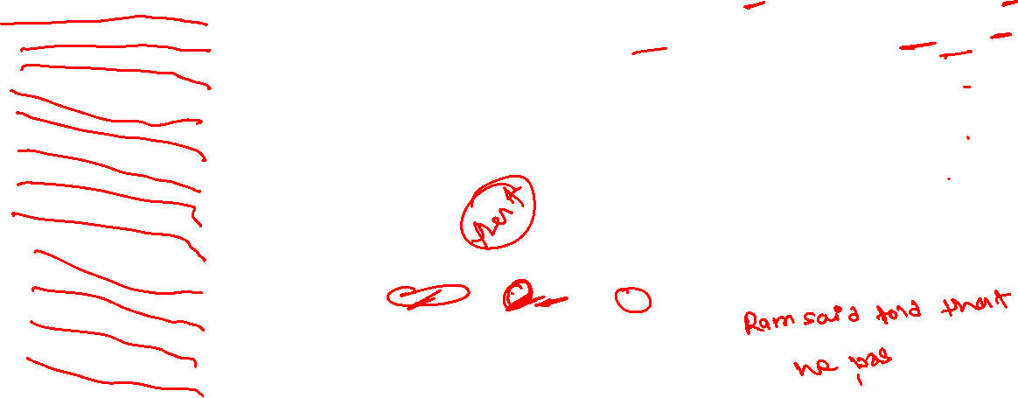
Reported Speech – 1 ( Fix)
Direct | Indirect
I we You My our Your Me Us Mine Ours Your Now | He, she They He, she, they His, her Their His, her, their Him, her Them His, her Their His, her ther Then
Ram said to her," I am selling my house". ( change into indirect) Hari said, "she is calling her friend". They said, " we may pass in our exam". He said , " the sun is hot". They will say,"we shall win the race". Did you hear me? ( she asked me…. Please help the poor ( he requested ….) The headmaster say, "how many of you are there? What is your name? ( he asked me…. I have been to france( he says Students said to the principle, " can you mange the extra classes trough virtual process?

Slide 40

Relative clause
Practice Questions 1. There is a lady ……… …….. wallet has been stolen. 2. Do you know the man … …sold these glasses? 3. The knife… ….you cut the bread with is very sharp .(who/whose/which) 3. Why do you blame him for everything …that… goes wrong? 4. A cemetery is a place… … dead bodies are buried. 5. This school is for those children ……. Mother tongue is not nepali. 6. I don’t know the name of the person … …I speak over the telephone. ( who/whose/whom) 7. This is the house . The house belongs to my uncle( who/whom/where/ which) 8. The driver,… .. was driving along the raod, was carefully. ( put the appropriate connective/ relative clause)
Who | को (person) ( subject….. verb
which | जुन ( things, animals)
What | के (thoughts)
That | त्यो ( person, things, animals but only use)
Whom | जसलाई(Person but use in object place)
Whose | जसको( person …. And pronoun/noun )
When | कहिले ( time period)
Where | कहाँ ( place)
Why | Reason

Slide 41
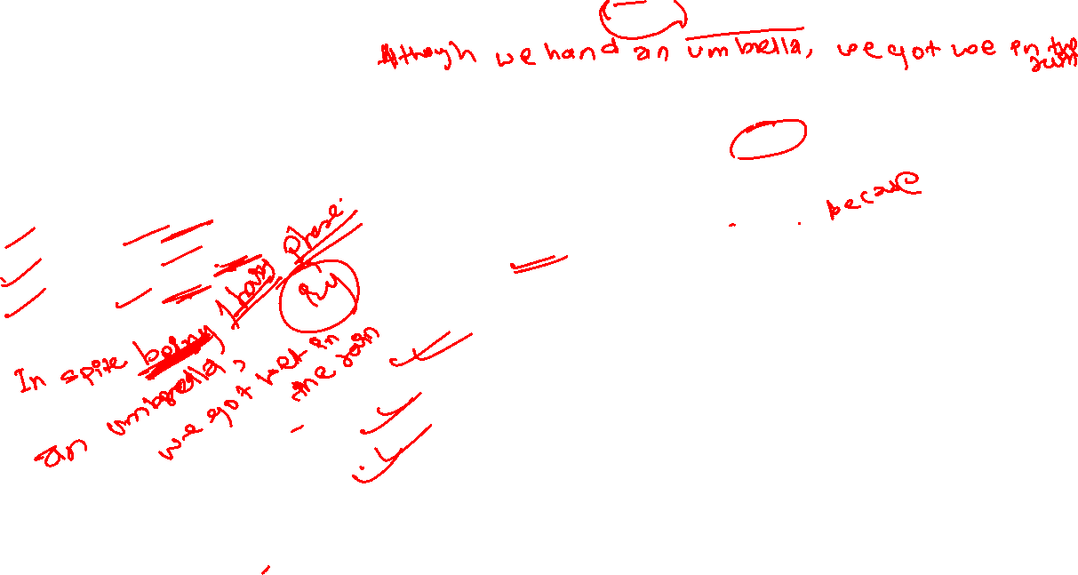
Connective/ Conjunction
Although + subject+ verb + object ( even though, though)
Despite + + ing noun/phrases/ genres
In spite+ ing+ noun/ phrases …..
despite the fact that+ …….
Because ‍= किनभने
Unless = until ( जबसम्म)
so that ‍= त्यसकारण
We got wet in the rain, We had an umbrella.( use appropriate connective) Ram is a very handsome, he still unmarried. ( use approparte connective) It is impossible for one to successes unless/because . One works hard. ( put correct connective in the space) I couldn’t submitted the assignment on time… …I was out in the country ( put connective) She worked hard…………… she didn’t pass her exam. ( join the connective" although") I wanted to go back from office…… I was feeling uneasy. ( use the connective/ because, so that/ whichever) …… He is rich, he is always dressed in rags. ( put the correct conjuction) I am very tired today, I walk for long time . ( use even though)

Slide 42
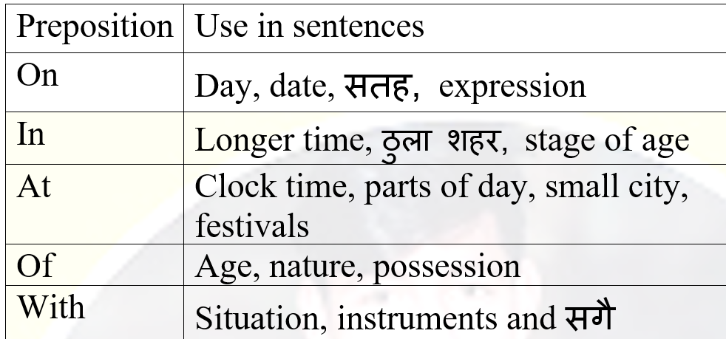
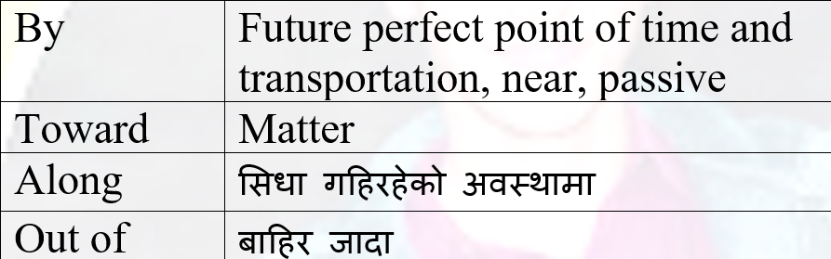

Preposition- 1 marks Fix
Link between two words
Pre= पहिले
position = ठाउ
Direction
Time
place
I do not in fact, know who she is staring … .. ( on/in/at/with) ( Put the suitable preposition) He was just come … ….6ö clock. (at,in,with) Rita was going to market … ..(in/ with/at/of) their kinship. He was coming… …..me( towards/ with/off) She is 6 years old … lovely in nature (of/in/at/with)

Slide 43
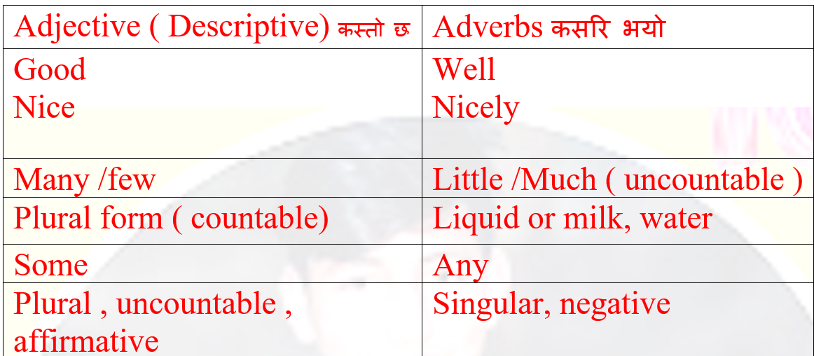
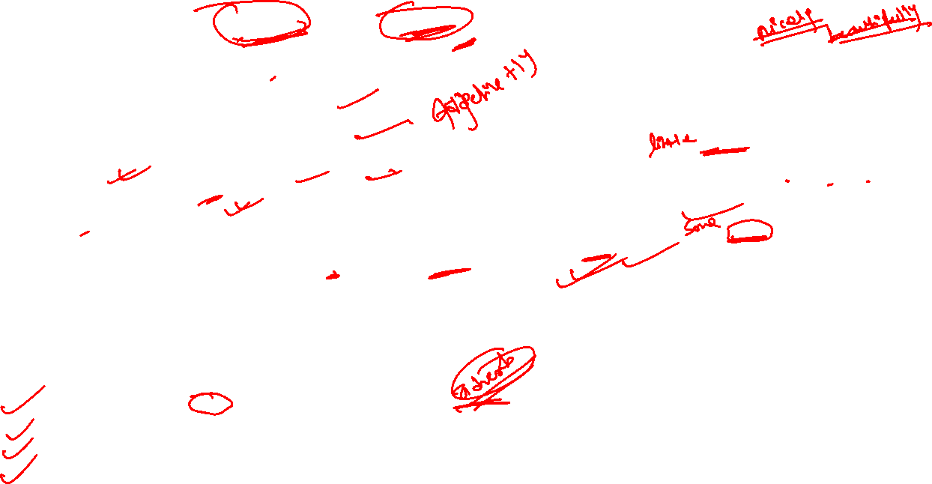
Practice Questions The little girl dance really… ..in the annual program of the school. ( choose the approparte adverb) This year the whole winter season was dry. There was very… …. ..( little /many/ more) rain. ( choose the appropriate word) Health care in Nepal is not as… …..as it is abroad. ( use 'expensive' appropriately) Can I borrow… …....books from you?( choose the any/some) The cool breeze blew … …... on her face ( complete the sentences use appropriate adverb)
Adjective and Adverb
Extra Question The hungry dog barked loudly at the stranger. (Identify the adjective in this sentence: ) She carefully painted the picture. (What is the adverb in this sentence, and what does it describe? ) He is a quick runner. (Rewrite the sentence using an adverb instead of an adjective: ) The students completed the test ___.(Fill in the blank with the correct form of the word (adjective or adverb): )

Slide 44

Model Verb
Modal Verb | Use | Example Sentence
Can (सक्छ) | Ability / Permission | I can swim.
Could (सक्थ्यो) | Past ability / Politeness | I could read at five.
May (सक्छ / अनुमति) | Permission / Possibility | May I come in?
Might (सम्भावना) | Possibility | It might rain today.
Must (अनिवार्यता) | Necessity / Obligation | You must wear a seatbelt.
Shall (गर्छु / गरौं) | Suggestion / Future (formal) | Shall we go now?
Should (गर्नुपर्छ) | Advice | You should sleep early.
Will (गर्नेछ) | Future / Promise | I will help you.
Would (गर्थ्यो / गर्नुहुन्छ?) | Polite request / Hypothetical | Would you like tea?
Practice Questions The street had a nasty jam. There ……( might/must/could/would) have been a demonstration of some political parties ( choose best model verb) People……….think interesting but I think it is pathetic ( use might/could/should to complete sentences) Look! The man is laughing out loudly jumping on the floor. He ……( can/must/will/would) be mad ( choose bet one in the blanks)

Slide 45
1. Read the following text and complete the tasks that follow. [15]
Can you imagine a college without walls, professors or classrooms ? Educator Bunker Roy can. More than 40 years ago, Roy, now 69, founded the Barefoot college in Tilonia, Rajasthan. His school admits rural women, often grandmothers and teaches them the basics of solar engineering and freshwater technology. His efforts have yielded enormous benefits. When the women return to their homes, they are trained enough to provide their communities, some of the world's most lonely places, with electricity and clean water. They also gain something important: a new found self confidence. The Barefoot model has already been used to empower women throughout Asia, Africa, and Latin America. Last year, former president, Bill Clinton presented Roy with a Clinton Global Citizen Award, which honours leaders who are solving the world's problems in effective ways.
If you go all over the world, to very remote villages, you will often find only very old people and very young people. The men have already left. So, two ideas were put into practice in order to make the Barefoot model work. First, it was declared that men are untrainable, restless, always ready to move, ambitious, and they all want a certificate to show for their efforts. And the moment you give one of them a certificate, he leaves the village looking for a job in the city. That is how, the simple, practical solution of training grandmothers came up. They are sympathetic, tolerant, willing to learn, and patient. All the qualities you need are there. And the second idea was not to give out certificates. Because the moment a certificate is given, a woman, like a man, will see it as a passport for leaving rural areas and going to urban areas to find a job.
Barefoot college follows the lifestyle of Mahatma Gandhi; students eat, sleep and work on the floor. They can work for 20 years or they can go home the next day. As of today, 604 women solar engineers from 1083 villages in 63 countries have been trained. The engineers have given solar power to 45,000 houses. These were done by women who had never left their homes before. They hate the idea of leaving their families and getting on a plane. When they reach India, sometimes after 19 hours of travel, they are faced with strange food, strange people and strange language. All the training is done in sign language. Yet in six months, they will know more about solar engineering than most university graduates. Some women face problems at home for attending college. Most of the husbands do not like their wives going to these colleges and tell them not to come back if they do so. But, on her return when she is able to help, provide her village with solar electricity, her husband wants her to get back home. The respect she now has is enormous and she considers, herself no less than solar engineers. Bunker Roy dreams of providing the world's 47 least developed countries with Barefoot college trained grandmothers, and solar-electrify more than 1,00,000 houses.

Slide 46
A. Complete the following sentences using the words highlighted in the text. Two of those words are not necessary. [5x1=5 ]
a. I could not understand what he is saying, Can you tell me which..... he is speaking?
b. The children in my class always become ....... near the end of the lecture.
c. A group of volunteers ...... a club and started to raise funds to help the poor people.
d. On completion of the training, everyone will be awarded a .....
e. I have no idea why she is behaving in a ... way today.
B. Read the text again and write TRUE if the statement agrees with the information given in the text. FALSE if the statement contradicts the information given in the text. NOT GIVEN if there is no information in the text. [5x1=5]
a. Barefoot college was established forty years ago.
b. According to the passage, Bunker Roy is sixty nine years old.
c. Roy's father encouraged him to set up Barefoot college.
d. Barefoot college enrolled only grandmothers who are willing to leave their homes.
e. Majority of the men from the remote villages moved to city in search of work.

Slide 47
C. Read the text again and answer the following questions in ONE SENTENCE each. [5x1=5]
a. In what way do you think Barefoot college is different from other colleges?
b. How was Roy's work recognised?
c. Why does the author mention the word 'passport' in the second paragraph?
d. Do you agree or disagree with the ideology of Bunker Roy? Why, why not? Give a reason.
e. What is the main idea of the text?

Slide 48



